Slide 1
Housing First for Youth
A housing and support solution for Looked After Young People with complex needs.

Slide 2
Simon Community Housing First for Youth Service
A preventative approach to reduce homelessness and promote stability within a chaotic LAC (Looked After Children) population
A service that is resilient and flexible,
Accommodation and community-based elements, to be delivered in a large urban centre with diverse populations and providing a range of life skills.
Access to 24-hour support due to their vulnerability
Early intervention: providing a flexible housing and support solution to LAC aged 16+ years, who without such intervention would enter adult homelessness at 18.

Slide 3
Independent Evaluation
2018 – 2022; Dr Olinda Santin QUB
Calculating and describing the total number of service contacts via collated service data
Young people’s experience and perspectives of Housing First for Youth (semi-structured interviews)
Housing First for Youth staffs experience of delivering the service (focus groups and semi-structed interviews)
Explore the impact of the service from the perspectives of social workers, personal advisors, team leaders and managers (online semi-structured interviews)
Explore the impact of the service and the factors affecting service delivery from the perspectives of partner stakeholders (Housing First for Youth Strategic Group- online survey).

Slide 4
Young People’s Experience
All had experienced multiple placements, issues with mental health, addiction, confidence, low mood, aggression (which led to assault)
All young people felt supported, required 24 hrs support, reduced risk- feeling suicidal, under the influence (esp. at night)
Described service as providing ‘chances and forgives you’, space to make mistakes and ‘stickability’ enabled trust and learning
Multiple tenancies lost but still supported and accommodation found

Slide 5
Young People’s Experience
Mental Health- HF4Y a lifeline and lifesaving
Help to receive medical attention for suicide attempts and self-harm
Preventative interventions based on knowing the young person (talk, distract, manage)
Fewer admissions to hospital
Improvements in negative emotions
Improved confidence and self-esteem
Improved life tasks
Better management of anger or aggression, disappointments, and ‘No’
Less abusive outbursts
Reduction in drug/ alcohol use

Slide 6
Young People’s Experience
Improvements in social skills - education, employment, daily living skills, staying at night without staff
Support with family relationships- navigating and maintaining contact with birth families
Areas of improvement
Building independence – reliance on staff
Building relationships with staff- high turnover, impact of shift work

Slide 7
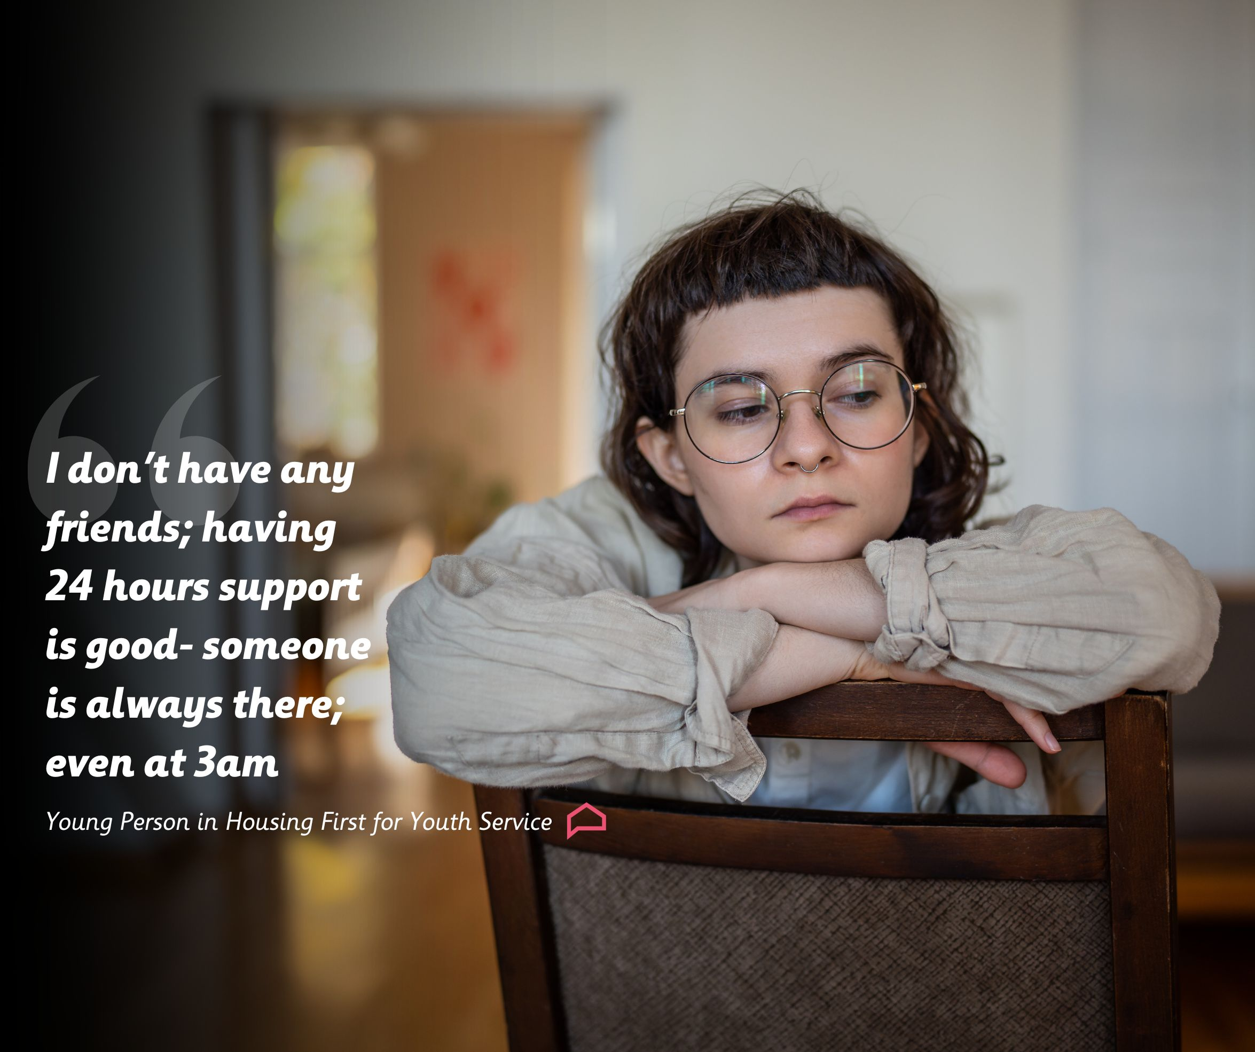
What our Young People say about Housing First for Youth:

Slide 8
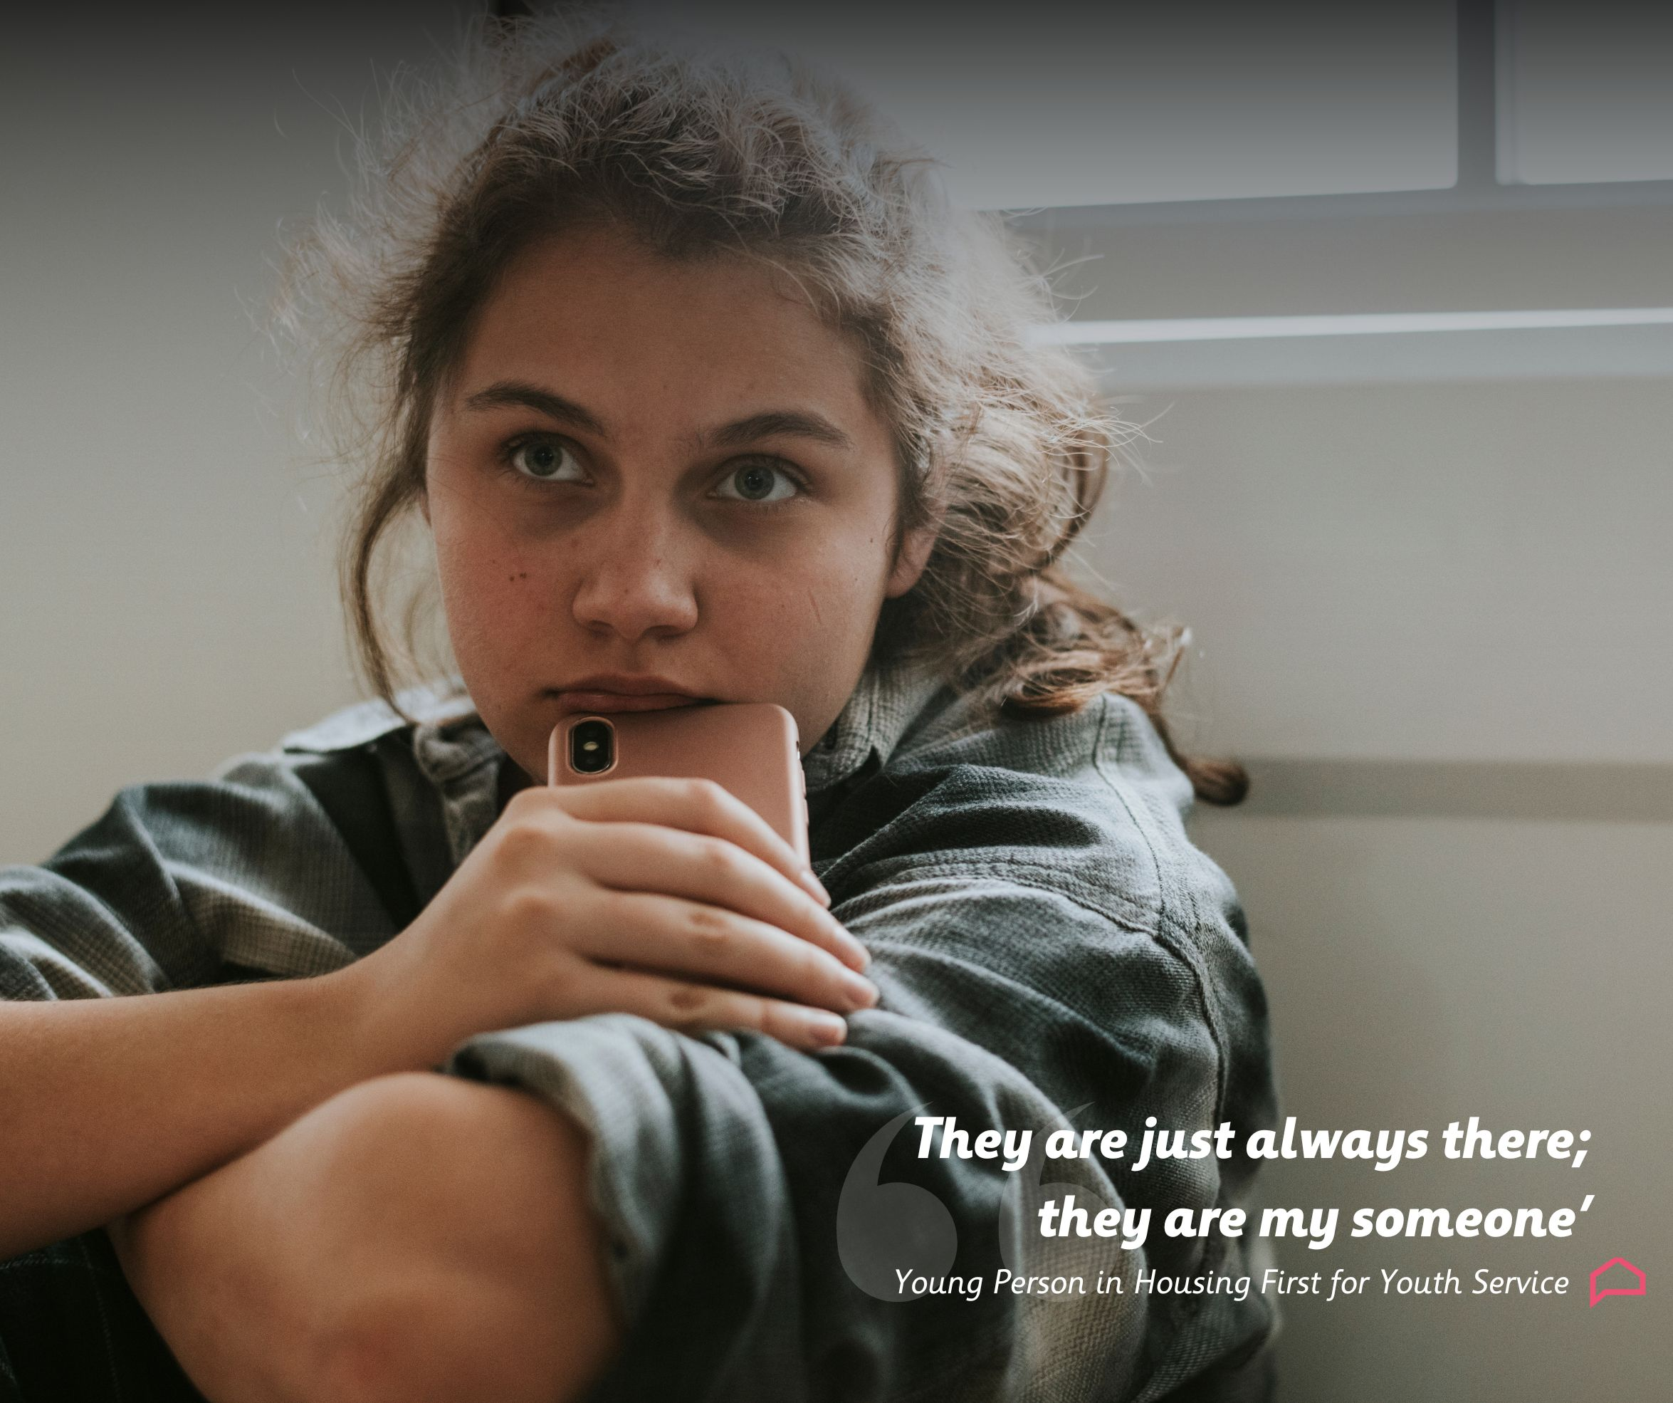
What our Young People say about Housing First for Youth:

Slide 9
What our Young People say about Housing First for Youth:
“I didn’t have any friends, they were the only people I had.”
“I like getting out, doing something, clearing my head.”
“It’s good to go out and socialise with people who aren’t crazy and won’t get you into trouble.”
“They chill your brain a wee bit.”
“They stop me killing myself.”

Slide 10
HF4Y Staff Experience
Young people had multiple and complex needs, risk-taking behaviour
Service is a ‘Life Support’
Low threshold for support and stickability works
‘we work hard to make life safe for our young people.’
Impact
managing risk and prevention of premature death
Increased maturity, regulated responses, having friends and positive relationships
Service delivery challenges
Independence and dependence
Lack of housing options
Communication

Slide 11
Social Work Staff Experience
Young people had multiple and complex needs- violence, mental health, risk-taking behaviour
Positive impacts- crisis response, building positive relationships, education and employment
Stickability- persistent and committed staff despite challenging and resistant behaviour from young people
Challenges
Access to housing
Intensive nature of support vs transition from service
Staff changes

Slide 12
Strategic Group Experience
Young people with complex and multiple needs
Improved housing options – prevented homelessness
Reduction of risk-taking behaviour and improvements in self-care
Community connections
Model is cost-effective
Effective partnership
Solution-focused and stickability at senior level
Challenges
Secure funding for ageing young people
Sourcing suitable housing
Staff retention and burn out

Slide 13
Key Findings
Effective model for young people with complex needs
Positive impact: physical, psychological and social health
Key to success planned and slow transition into service
Acknowledged as a lifesaving model
Value of HF4Y approach
Key Considerations
Access to suitable housing
Intensive support vs independence
Staff turnover
Impact of shift work
Future funding

Slide 14
‘Safeguarding and Response’ Unit
24/7 rota, with
double-cover’ at all times
‘peak-time’ cover allowing for greater resource at busier times (11am – 3am)
Pro-active welfare checking of young people as per standard safeguarding protocols of the service (particular focus on under-18s)
‘On-call/ response to young people in crisis or distress
Incident response
‘Casework’ Unit
Dedicated key worker
Pro-active delivery of support to young people based upon their support plan
Appointment/routine based,
structured delivery of support sessions
progressing ability to manage household, harm-reduction, educational or employment needs, and community integration
Assessments
Liaising with social work teams
Incident reflection, learning and response

Slide 15
Benefits of research and reconfiguration
Responsive to learning from evaluation
Provides response
Provides for relationship development and growth
Model is flexible to respond to requirement for independence, but also providing safety net
Safeguarding inputs do not reduce support intervention
Better use of resources and values for money
Staff role clarity and development opportunities
Service could support more young people

