Slide 1
The emerging impact of Housing First for Youth in Canada and Europe
Stephen Gaetz Professor, Faculty of Education, York University
President & CEO, Canadian Observatory on Homelessness
Samara Jones FEANTSA
Ashley Ward Canadian Observatory on Homelessness
Notes:
Melanie welcome and introduce everyone
AWHC and the COH acknowledge the location of this meeting on the traditional territory of many Indigenous Nations. The area known as Tkaronto has been care taken by the Anishinabek Nation, the Haudenosaunee Confederacy, the Huron-Wendat, and the Métis. It is now home to many Indigenous Peoples. We acknowledge the current treaty holders, the Mississaugas of the New Credit First Nation. This territory is subject of the Dish with One Spoon Wampum Belt Covenant, an agreement to peaceably share and care for the Great Lakes region.

Slide 2
Youth
Homelessness
Social Innovation Lab
Notes:
Melanie welcome and introduce everyone
AWHC and the COH acknowledge the location of this meeting on the traditional territory of many Indigenous Nations. The area known as Tkaronto has been care taken by the Anishinabek Nation, the Haudenosaunee Confederacy, the Huron-Wendat, and the Métis. It is now home to many Indigenous Peoples. We acknowledge the current treaty holders, the Mississaugas of the New Credit First Nation. This territory is subject of the Dish with One Spoon Wampum Belt Covenant, an agreement to peaceably share and care for the Great Lakes region.

Slide 3
1
Research on HF4Y in Canada

Slide 4
1
2
3
Currently homeless youth
Early Intervention: youth leaving care
ENDAAYAANG
Supporting Indigenous youth

Slide 5
Randomized Controlled Trial
Both HF4Y group and Treatment as Usual group were tracked for 48 months.
Quantitative Surveys – every six months
A subgroup participated in Qualitative Interviews every six months.

Slide 6
Preliminary Outcomes Data (24 months)
Gains for HF4Y group in comparison to TAU in the following areas:
Housing stabilization; Physical health; Psychological health; Social Relationships; Education; Employment; Perceived social support (Family, Friends, Significant others) Resilience.

Slide 7
2
Comparative
Research on HF4Y Europe & Canada

Slide 8
INTRODUCTION
Housing First for Youth (HF4Y) is distinct from Housing First for all ages: different supports and partnership networks are required for this approach to succeed.
HF4Y programs do not often have the ﬁnancial means to develop evaluation or assessment tools, or to include extensive evaluation in their programming.
Evidence from HF4Y providers in Canada and Europe indicate a demand for support to ensure they are developing HF4Y programs and approaches that are true to the principles, often within less than ideal housing or policy frameworks.

Slide 10
GOALS
Identification of HF4Y programs in Europe and in Canada
Capture the stories of Founders
Validate a Brief Fidelity Self-Assessment Tool for HF4Y
ENHANCE OUR UNDERSTANDING OF HOW TO TAKE HF4Y TO SCALE

Slide 11
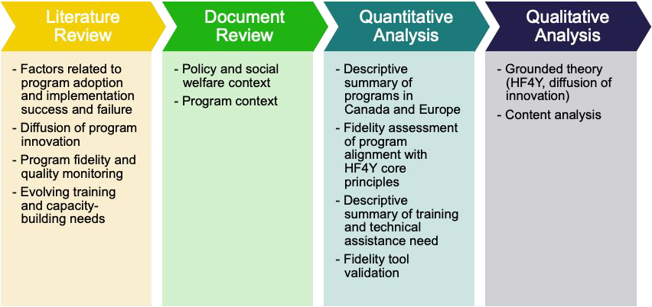
METHODS

Slide 12
METHODS
METHODS

Slide 13
METHODS

Slide 14
METHODS

Slide 15
QUALITATIVE METHODS

Slide 16
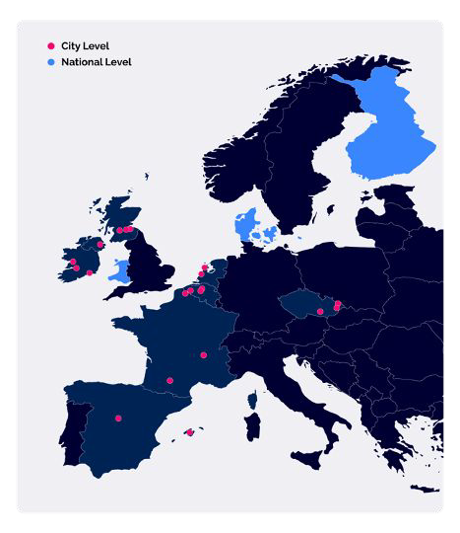
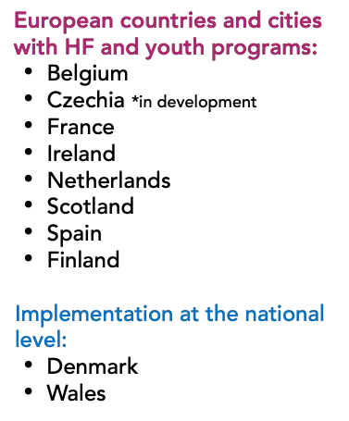

Slide 17
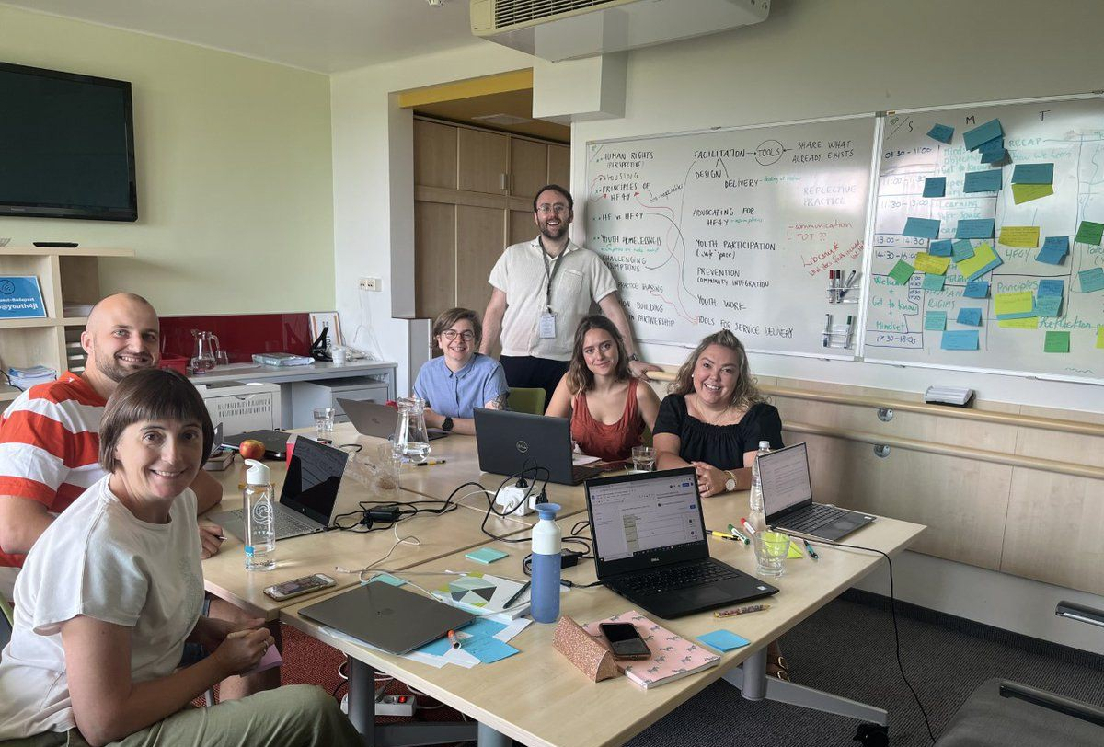
RESULTS
Quantitative data analysis: Preliminary results
29 completed Qualtrics surveys from 10 participating countries
Issues:
Technical: Scoring: item weighting; category summation of core principles and priorities; addressing issues external to the program
Practical or “real-world” issues impacting the technical:
Understanding the intersections of tool completion with staff roles
Addressing areas for further training (e.g., housing location)

Slide 18
RESULTS
RESULTS
Initial ﬁndings include consensus that HF4Y works for young people (homeless or at risk of homelessness) in Canada and Europe
Young people in or exiting or with experience of the care system are particularly vulnerable; can beneﬁt from HF4Y; partnership networks across care systems, HF4Y and other sectors are necessary for success
Housing availability and ongoing cost of living crisis in Canada and Europe is a signiﬁcant obstacle to expanding and scaling up the HF4Y approach

Slide 19
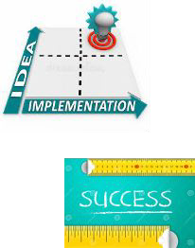
CONCLUSIONS & NEXT STEPS
CONCLUSIONS AND NEXT STEPS
Social programs such as HF programs for youth, require time to gain stability, or “footing,” to demonstrate their effectiveness. (This means time in typical or expected operations.) Likewise, effective social programs require strong ﬁdelity to their original program model in order to produce the desired outcomes for youth.
Fidelity screeners can provide important points of feedback that support program development, including staff development, program expansion, a redeﬁnition of an intake or assessment system, etc.
And, at the same time, ﬁdelity assessment must include real-world conversations holding everybody accountable to the original/intended program model. More practice-based research must be conducted to further understand training programs.

