Slide 1
Housing First and the Prison System
Nicholas Pleace

Slide 2
Housing First research
Drawing on evaluations of 21 Housing First projects working in the UK (2010-2024)
Of which 12 were longitudinal, between two and five years in duration
And evidence reviews and analysis
For the Finnish, French, Scottish and Welsh governments, the Northern Ireland Housing Executive and the homelessness sector
And strategic development of Housing First in the City of York
Three years and counting in changing the City strategy to Housing First (almost there)

Slide 3
Housing First and offending
In the UK the terminology is ‘offender’ and ‘ex-offender’
There has not been evidence of a strong association between long prison sentences and homelessness, because of probation support (and age)
And people released from prison who are assessed as presenting an ongoing risk are managed through Multi-agency public protection arrangements (MAPPA) which uses an MDT and provides housing in a sort of surveillant Housing First
Homelessness and offending are connected by a mutually reinforcing relationship between offending, addiction, mental illness and repeated short term imprisonment

Slide 4
Housing First and offending
Housing First appears able to often reduce crime among (forgive the British NHS terminology) frequent flyers
Frequent flyers = recurrent and long term homelessness associated with multiple and complex needs
Frequent flyers = “rubbish at crime” with multiple and complex needs, get caught, processed and receive short sentences for petty theft/drug related offences constantly
Line between offender and victim is very blurred especially among frequent flyers and especially women where their crime is often occurring in the midst of abuse and violence
Housing First seems to break these cycles

Slide 5
Housing First and reduced offending
Long been understood that social support and familial networks, stable and suitable housing and economic engagement reduce re-offending
Housing First ticks those boxes
There are other benefits which have been recorded through qualitative and co-productive work with people using Housing First services
Better management of addiction
Better management and better access to treatment for mental illness
Self-esteem
Safe guarding and protection offered by intensive Housing First services, e.g. reducing the risk of cuckooing and other exploitation of vulnerable people and of domestic abuse

Slide 6
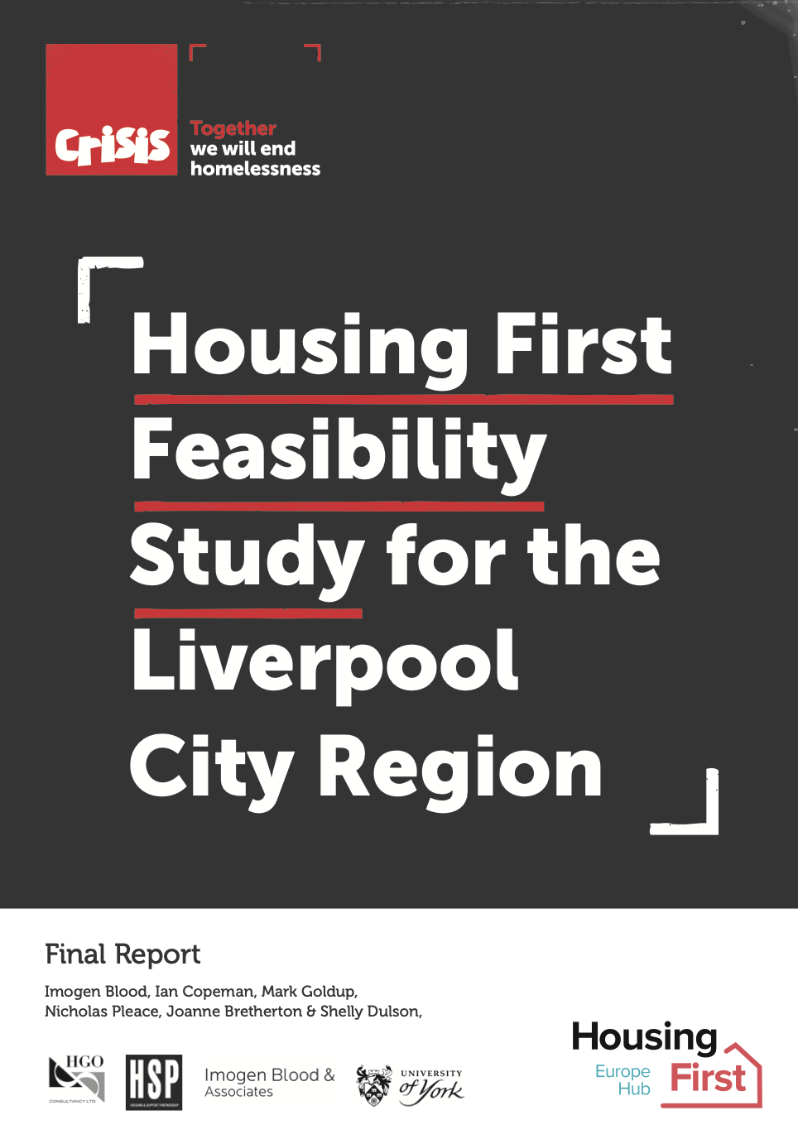
Key challenges
Longstanding challenges with resourcing in the prison and probation systems
Catastrophic privatisation of probation (eventually reversed)
Systems that lack the resources to provide preventative services, integrate with homelessness and Housing First systems
In a context in which mental health services are also very short of resources
Uncoordinated, under-resourced criminal justice systems a pan-EU problem, it is hard to integrate Housing First into systems that are struggling
And of course the supply of affordable, suitable and secure housing is a challenge, as is social/private landlord cooperation

Slide 7
Three takeaways
Housing First also offers the right kind of support to break the cycles of repeated offending
And to break the associations between repeated offending, mental illness, addiction and long-term/repeated homelessness
There are limits, Housing First needs to be integrated into a coherent, multi-agency and multi-disciplinary strategy that sits comfortably within homelessness and criminal justice priorities and both Housing First itself and the agencies it needs to work with must be properly resourced

Slide 8
Housing First and the Prison System Thanks for your endurance
Nicholas Pleace

