Slide 1
Housing First and the Criminal Justice System
Kerry Quinn, APPO Prison’s Region North
KAQuinn@probation.ie

Slide 2
The Client’s Voice
“You come out clean from prison and you are just thrown out into a hostel, if you are lucky – people using all over the place – it’s just too hard.”
“Sometimes you’re left like dogs, a few of us in the cells, some of the girls you might be in with have serious issues, - and then you’re let out and told to ring the Freephone – it’s shocking, no place to go.”
“It’s just so hard, and it’s getting worse – younger lads coming into the prisons and only dabbling and then they’re put into the hostels when they’re let out or sleeping rough and they do be destroyed after a few years.”
“When you’re just in and out and in and out from the prisons to the hostels or the street, you just lose hope.”

Slide 3
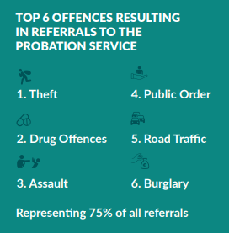
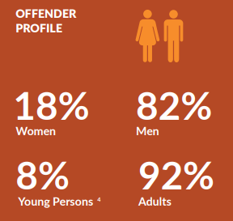
The Probation Service
Our Vision: Safer and more inclusive communities where offending, and its causes, are effectively addressed.
2023 in numbers:
16,989 offenders worked with in the community.
3,175 offenders worked with in prisons.

Slide 4
Homelessness is a major barrier to effectively supporting clients to address offending behaviour, and its root causes.
Probation Service Strategic Engagement on Homelessness
Probation Service Strategic Statement Action Plan 2024: Commits to develop a Housing and Homelessness Position Paper.
Working with Department of Justice and Irish Prison Service to support forthcoming academic research on the scale and impacts of Homelessness in the Criminal Justice System.
Improving data collection on housing and homelessness for Probation Service clients.
Funding community based organisations to provide transitional accommodation options for Probation Service clients leaving prison or in the community. (Priorswood House, Trail, Tus Nua, Outlook)
Working collaboratively with multi-agency partners on the Criminal Justice Housing First pilot programme and development of its future iteration.
Commissioning independent evaluation of Criminal Justice Housing First pilot programme.

Slide 5
Criminal Justice Housing First Pilot Programme
Operated in Dublin since October 2020.
Oversight Committee – Probation Service, Irish Prison Service, DRHE, Director of National Housing First.
Steering Committee – Probation Service, Irish Prison Service, DRHE, Director of National Housing First, HF Service Provider
Target: 75 Tenancies
As of September 2024:
117 applications received, 62% custody referrals, 38% community referrals.
48 tenancies created.
24 active tenancies.
Key reasons for tenancy breakdown included successful transfer of tenancy, long-term custodial sentence, estate management issues, death of client.
Barriers:
High Risk of Offending amongst Referrals.
Estate Management Concerns.
Identifying properties in advance of release.
Strengths:
Strong collaborative relationship between agencies essential to success.
Case management advocacy.

Slide 6
Housing First and the Criminal Justice System
Moving Forward
Integration and national expansion of CJHF within overall Housing First programme.
Informed by forthcoming independent evaluation of CJHF pilot.
Supported by improved data collection on housing and homelessness amongst Probation Service clients.
Homelessness and the Probation Service
Establishment of SOP by Complex Prison Release Steering Committee (OMOG Multi-Agency Response).
Addressing structural barriers to housing for people with convictions informed by forthcoming academic research.

Slide 7
Thank you
Key Takeaways:
Prevention
Collaboration
Innovation
Kerry Quinn, APPO Prison’s Region North
KAQuinn@probation.ie

