Slide 1
Homelessness policies in Finland
19.11. 2024 Housinf First Conference, Dublin
Director Jarmo Lindén
Housing Finance and Development Centre of Finland

Slide 2
Finland has provided Annual Reports on Homelessness since 1986 = basis for action
1987 was UN declared “International Year of Shelter for The Homeless (IYSH)”
In Finland all municipalities have been asked by ARA (=Housing Finance and Development Centre) to provide PIT data (Mid-November) on the number of homeless people every year since 1987 based on Ethos light definition
Municipalities gather the information on homeless persons from different sources e.g. housing officials and municipal rental housing companies (people applying for subsidised housing), social service officials and service providers (information on customers)
Municipalities are also instructed to use register data (Social Insurance Institution) to complete their estimate on the number of homeless persons and families
The information on homelessness is gathered for different population groups (men/women, young people under the age of 25, persons with immigrant background, single persons/families)
The survey data also includes information on the share of long-term homeless persons since 2008 when Housing First policy was intensified

Slide 3
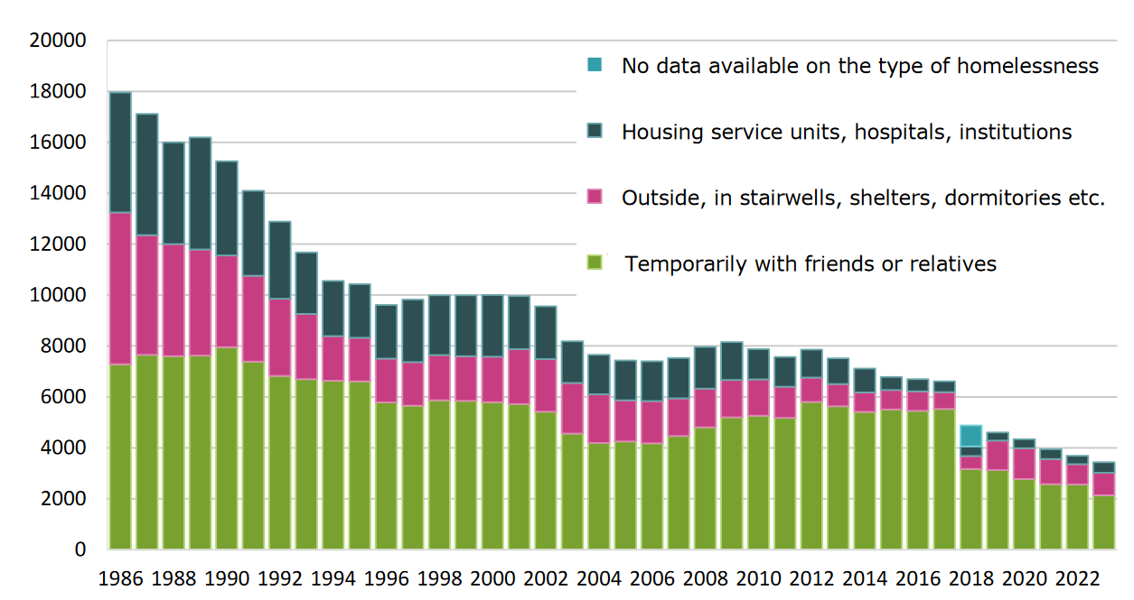
Homelessness Reports has been published since 1986 – 38th Edition on 2023 is available in English https://www.ara.fi/en-US/Materials/Homelessness_reports/Homeless_people_2023(66534)
Alone living Homeless:
2008: 8260
2023: 3429
Change - 4831
= - 58,5% since
Housing First was implemented 2008
In 2018, the City of Helsinki specified its procedure of compiling numbers on
homelessness, which reduced homelessness in Helsinki. Due to this change, the numbers are not comparable to previous years
Temporarily with friends or relatives

Slide 4
It was easy to decrease homelessness based only on lack of affordable housing
Using the staircase model, Finland more than halved homelessness from 1986 to 1994, but then progress slowed
Between 2004 and 2008, the number of single homeless individuals was measured between 7,400 and 7,960
Finland’s annual homeless reports attributed the stalled progress to a group of people with high support needs who were experiencing long-term homelessness
New solutions were needed

Slide 5
Systemic Change 2007-2008
Housing ministeri in 2007 centre-right government Jan Vapaavuori wanted to make a difference. He nominated a group of Finnish experts who analyzed the problem and issued a report called “Name on the Door” argued that eliminating long-term homelessness
“requires adopting the Housing First principle where a person does not have to first change their life around in order to earn the basic right to housing. Instead, housing is the prerequisite that allows other problems to be solved”
“In the Housing First model, a dwelling is not a reward that a homeless person receives once their life is back on track. Instead, a dwelling is the foundation on which the rest of life is put back together”
Government made a Decision on new homelessness policy in February 2008 and made agreements with 10 biggest homelessness cities with concrete action plans
There was a strong operative approach in implementing the programme

Slide 6
Great Leap Forward in Finland 2008: From Staircase Model to Housing First

Slide 7
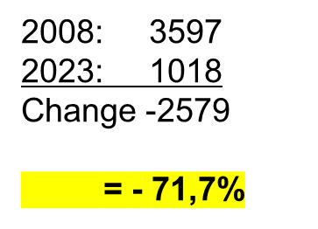
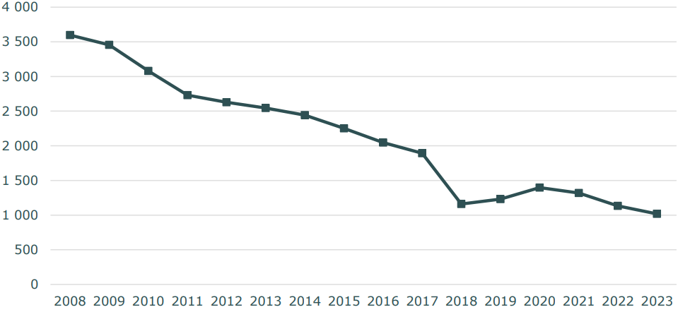
Number of long-term homeless
persons 2008-2023
Long-term homelessness refers to a homeless person who has a significant social or a health problem, such as debt, substance abuse or mental health problems, and whose homelessness has been prolonged or is in danger of being prolonged due to a lack of conventional housing solutions and appropriate support services. Homelessness is considered long-term if it has lasted for at least one year or if the individual has repeatedly experienced homelessness over the last three years.
WHOLE

Slide 8
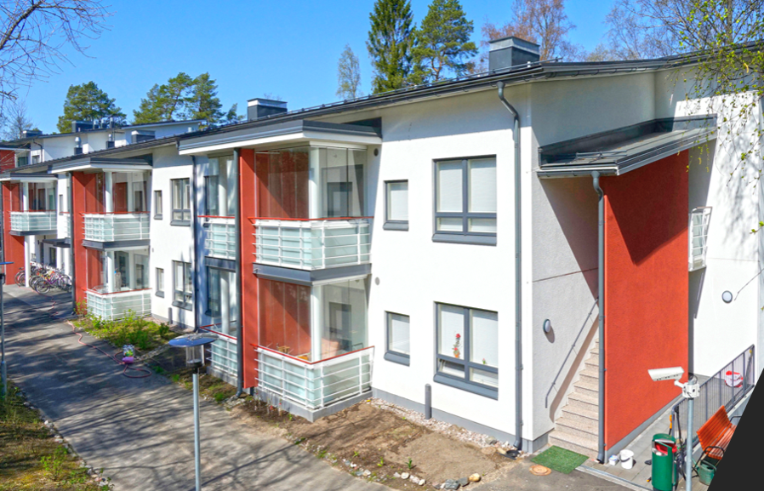
Housing First in Finland since 2008
Since 2008 the Housing First principle has been the cornerstone of Finnish strategy and policy to end homelessness.
Housing First in Finland is first and foremost a systemic model, which means that housing solutions and support services are organised according to this model
Housing First can refer to a way of thinking, a basic philosophy, a service model or a way of working.
Väinölä (Y-Foundation), New building in 2014 with 33 apartments, total cost 4,9 M€ = ARA grant + subsidy loan

Slide 9
What has been needed for the success of Finnish Housing First model?
Political mandate - promise and engagement of the government and parties (of all types)
Common framework – Housing First in nationwide programmes to guarantee actions
State intervention – investments for funding housing (ARA) and support services
Implementation in cities – disruptive reform of housing and services, tailor-made support channelled to long-term homeless
wide professional and political consensus - co-operation between all partners- incl. NGOs- around same table (Steering boards on national and local level)

Slide 10
Common Framework – Housing First in National Programmes
2023-2027
PROGRAMME
2008-2011 PAAVO 1
2012-2015 PAAVO 2
2016–2019 AUNE
2020-2022 PROGRAMME
Housing First –principle was introduced: no shelters, but homes with own rental agreements. 2 143 new flats in total
3 523 flats for people experiencing homelessness. Professionals and experts by experience were hired.
Programme concentrated on preventing homelessness and special groups. Expertise by experience has become established as a part of homelessness work.
The Cooperation programme aims to halve homelessness by the end of 2022. The programme emphasizes the responsibility of the municipalities.
The Government i launched a programme to eradicate long-term homelessness in d
Notes:
Asunnottomuusohjelmat kootusti tässä.

Slide 11
The Danish National strategy on Housing First and transformation process
Karin Egholm and Karen Margrethe Korsholm
Dublin november 2024

Slide 12
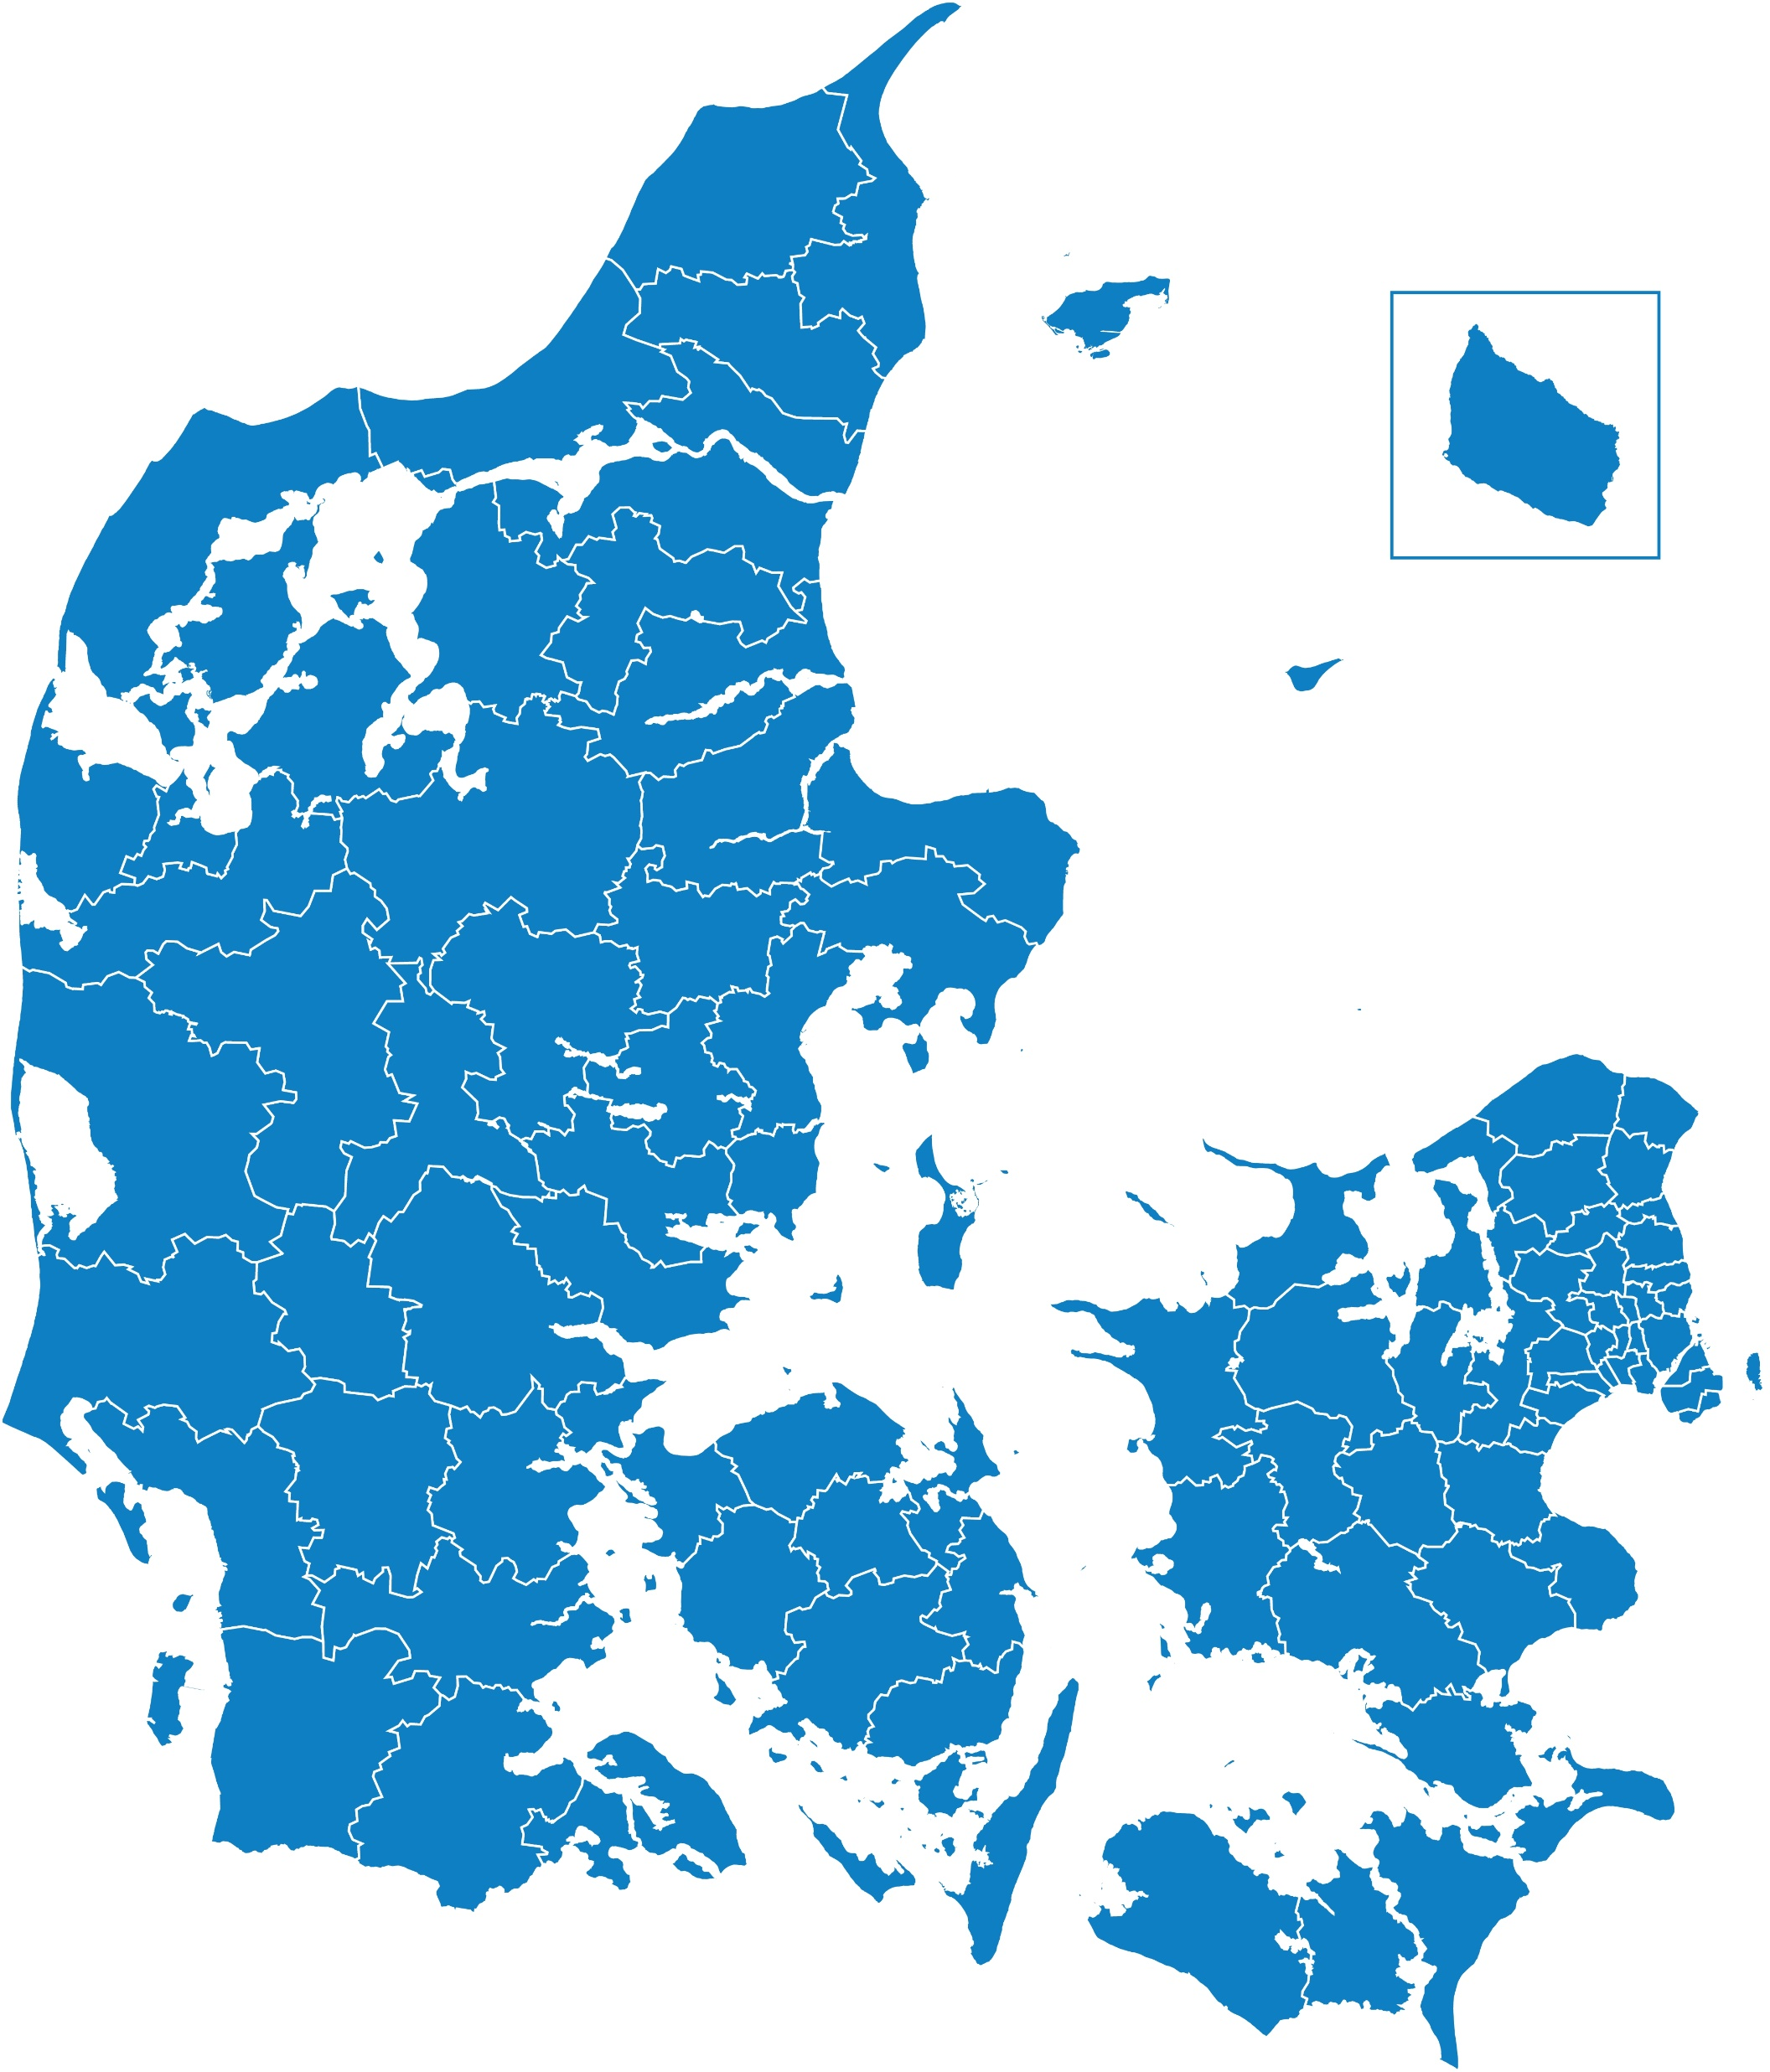
The social system in Denmark
Equal access to services.
Social System that is tax financed.
98 municipalities that play a key role in delivering the social service.

Slide 13
Homelessness in Denmark 2009-2024, week count (week 6)
Source: VIVE, Mappings of homelessness 2009-2024

Slide 14
Homelessness situation
Homelessness situation | 2009 | 2011 | 2013 | 2015 | 2017 | 2019 | 2022 | 2024 | Percent change 2022-2024
Rough sleeping | 506 | 426 | 595 | 609 | 648 | 732 | 535 | 503 | -6
Emergency night shelter | 355 | 283 | 349 | 345 | 305 | 313 | 248 | 317 | +28
Homeless shelter | 1.952 | 1.874 | 2.015 | 2.102 | 2.217 | 2.290 | 2.736 | 2.721 | -1
Hotels | 88 | 68 | 70 | 113 | 165 | 191 | 121 | 56 | -54
Family/friends | 1.086 | 1.433 | 1.653 | 1.876 | 2.177 | 1.630 | 1.152 | 1.447 | +26
Short term transitional | 164 | 227 | 211 | 178 | 169 | 121 | 98 | 90 | -8
Release from prisons | 86 | 88 | 64 | 90 | 68 | 72 | 49 | 35 | -29
Discharge from hospitals | 172 | 173 | 119 | 138 | 149 | 148 | 146 | 149 | +2
Other | 316 | 367 | 370 | 339 | 258 | 380 | 319 | 382 | +20
Unknown | 273 | 351 | 374 | 348 | 479 | 554 | 385 | 289 | -25
Total | 4.998 | 5.290 | 5.820 | 6.138 | 6.635 | 6.431 | 5.789 | 5.989 | +3
Source: VIVE, Mappings of homelessness 2009-2024

Slide 15
Health problems
Homelessness situation | Physical illness | Mental illness | Addiction problems | Both mental illness and addiction problems
Rough sleeping | 26 | 74 | 71 | 50
Emergency night shelter | 25 | 63 | 78 | 49
Homeless shelter | 32 | 61 | 64 | 41
Hotels | 29 | 59 | 59 | 45
Family/friends | 27 | 68 | 60 | 41
Short term transitional | 24 | 59 | 63 | 38
Release from prisons | 26 | 63 | 78 | 39
Discharge from hospitals | 25 | 95 | 59 | 55
Other | 33 | 69 | 56 | 39
Unknown | 32 | 63 | 65 | 51
Total | 30 | 65 | 64 | 43
Source: VIVE, Mappings of homelessness 2009-2024

Slide 16
Historical view on the transition to Housing First in Denmark
2009-2013
17 municipalities
Method testing in a Danish context
2014-2016
25 municipalities
Implementation of Housing First
2016-2019
≥25 municipalities
Dissemination of Housing First
2018-2021
≥25 municipalities
A National Action plan to combat homelessness with Housing First
2021-
New political agreement to support the full implementation of Housing First in Denmark

Slide 17
The challenges in Denmark
70 pct. of people living in shelters are ready to move into own apartment but relevant housing is lacking.
Only 8 pct. of the target group is met by a Housing First-method.
Only 28% of people living in homelessness have an action plan.

Slide 18
The ambition
A NEW POLITICAL AGREEMENT
Combatting homelessness with increased focus on the Housing First-method
To reduce the number of homeless citizens significantly.
To end long-term homelessness.

Slide 19
Three focal points in the agreement
A NEW POLITICAL AGREEMENT
Combatting homelessness with increased focus on the Housing First-method
More affordable housing for people in homelessness and people in risk of homelessness
Rearrangement of the economic incentives structure for the municipalities to help people getting out of the homelessness situation
Various initiatives to support the full implementation of Housing First

Slide 20
Homelessness Action Plans 2008-2019: Public investments and expenditure (estimate)

Slide 21
Getting Rid of Shelters was done by ARA subsidies and loans
Housing options in Helsinki for homeless:

Slide 22
Koisoniitty - New Housing Unit for Long-term Homeless in City of Vantaa 2023
42 homes (studios), 5 in separate buildings (above)
ARA funding = 8,3 M€: 30% grant and 70% subsidy loan
Partly financed by the City

Slide 23
Health and social services reform started 1.1.2023 – effects homeless services too. Housing policy is still duty of municipalities, but services not anymore (except City of Helsinki)
This huge reform of public administration is one more reason for a new
National Homelessness
Programme: to guarantee
that housing and services
go hand in hand according HF model.

Slide 24
Services for Homeless are part of Finnish Welfare State services – not separate system
In Finland it would be impossible to handle support services for the formerly homeless who have received housing with ACT teams based on Tsemberis' model.
There would not be enough trained staff such as psychiatrists and it would become unsustainably expensive.
At the same time, a new separate organization of social and health services would be created, which would only serve the formerly homeless, and which would blatantly violate the principle of equality.
Since Finland has a strong and geographically comprehensive system of publicly funded social and health services intended for all citizens, support services for the homeless or those who have moved away from homelessness into their own housing must also be organized with the help of the existing service system

Slide 25
Towards HF 2.0 – Services for homeless should be better tailor-made for their needs
According to conservative estimates, approximately 1500 professionals and experts by experience work in Finland directly with clients who are homeless, who have received housing after periods of homelessness, or are at risk of homelessness.
These experts work in municipal and regional social, health and housing services as well as third sector service provider organizations and associations.
Thanks to the national Housing First strategy and the dedication of employees, Finland has succeeded in reducing homelessness significantly since 2008.
The strategy is now being renewed under the working title Housing First 2.0

Slide 26
Housing First 2.0
https://research.tuni.fi/uploads/2023/02/e806d7d0-jyvaskyla-nopsajalka_reportenglish_23.2.2023_pdf.pdf

Slide 27
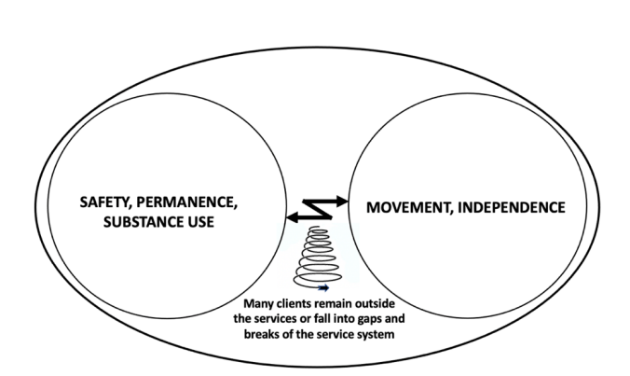
The Housing First 2.0 concept as a solution of the contradiction
“Escorted transfer” as the core idea of
the new model of working
The contradiction between permanence and mobility in homelessness work

Slide 28
Three focal points in the agreement
A NEW POLITICAL AGREEMENT
Combatting homelessness with increased focus on the Housing First-method
More affordable housing for people in homelessness and people in risk of homelessness
Rearrangement of the economic incentives structure for the municipalities to help people getting out of the homelessness situation
Various initiatives to support the full implementation of Housing First

Slide 29
More affordable housing - background information
20 pct. of the housing stock is non-profit.
One in four of the non-profit homes should be available for the municipalities to address urgent social housing tasks in the municipality.
The municipalities assigned around 11 pct. of the vacant non-profit homes with a rent below 470 EUR in 2021-2023.

Slide 30
More affordable housing - what’s new?
Different ways to use the existing non-profit housing stock
Intensified municipal referral to housing
A grant to support a temporary reduction in rent in 1.800 already existing apartments
Extension of the opportunity for municipalities to subsidy rent for 5 years (formerly 2 years) if you are moving from shelters and temporary accommodation to own apartment
Supporting the construction of new housing units
A one-time grant that permanently reduces the rent to 2.250 new non-profit apartments.
Funding:
135 mio EURO

Slide 31
Three focal points in the agreement
A NEW POLITICAL AGREEMENT
Combatting homelessness with increased focus on the Housing First-method
More affordable housing for people in homelessness and people in risk of homelessness
Rearrangement of the economic incentives structure for the municipalities to help people getting out of the homelessness situation
Various initiatives to support the full implementation of Housing First

Slide 32
Rearrangement of the economic incentives structure
Reduction in state reimbursement
State reimbursement covering 50 pct. of the costs for stays in homeless shelters in up to 120 days. 0 pct. reimbursement after 120 days. (From 2026 it’s 90 days).
Preventive measures – a new paragraph in the Act on Social Services
State reimbursement covering 50 pct. of the costs for support-in-housing for 2 years following a stay in temporary and emergency accommodation.

Slide 33
Three focal points in the agreement
A NEW POLITICAL AGREEMENT
Combatting homelessness with increased focus on the Housing First-method
More affordable housing for people in homelessness and people in risk of homelessness
Rearrangement of the economic incentives structure for the municipalities to help people getting out of the homelessness situation
Various initiatives to support the full implementation of Housing First

Slide 34
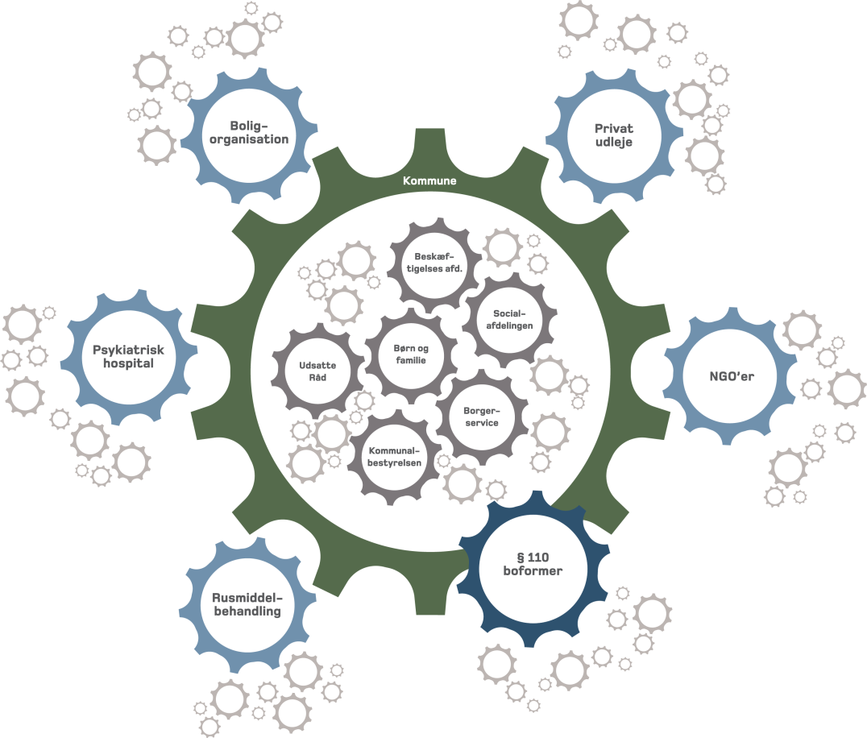
A National Partnership of stakeholders has been established
The central task is to follow the implementation of the Housing First approach and follow the development in the area - and continuously discuss any challenges.
Must ensure feed-back to the political level through annual reports.
The participants consists of more than 30 key actors from:
Civil society
Municipalities and regions
Foundation
Research
Ministries

Slide 35
Special Projects to strengthenThe Danish National strategy on Housing First and the transformation process
New parts of the laws (social and housing)
Taskforce against homelssness ind the municipalities who deals with the biggest problems
Implementations acitivties
ICM-støtte (support-in-housing) for young people in homelessness or in risk of becoming homelss.
Education for the employees, who work with people in Homelessness
HjemløshedIT – a digital system to document the compliance and development of HF and support-in-housing

Slide 36
The spread of Housing First through advising municipalities and homelessness shelters
The Authority of Social Services and Housing provides counselling, guidance and implementation support on Housing First to municipalities, homeless shelters and others operating within the field of homelessness.
The advisory function contains three tracks:
Individual counselling (1½ year)
Group based counselling (6 months)
General counselling (ad hoc and very short termed)
As part of our advisory function we offer different courses in Housing First and a documentations system.

Slide 37
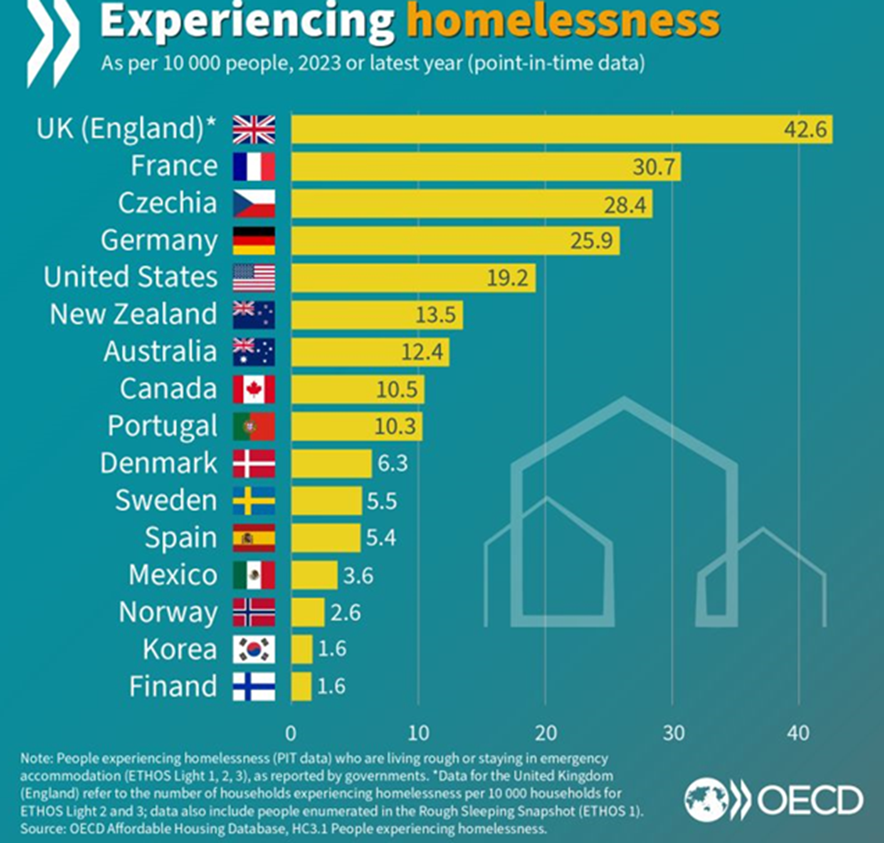
Finland has been successful…

Slide 38
Signs of future dangers are in the air: Completed evictions in Finland 2013-2023

Slide 39
Financialization of housing is endangering historical achievements - even in Finland
Rental housing stock 2010-2021- share of PRS and ARA:
Private rental housing (PRS) has been booming over last ten years
More and more housing is turning to a platform for profit-seeking
Results:
Rents in PRS have been rising fast
Both amount and share of ARA rental housing is decreasing
Share of home-ownership in younger generations is rapidly going downwards (Generation Rent)
68%
59%
41%
32%

Slide 40
Difference in rents (€/sq2) in Cities (2 rooms apartments) Q1/2023 Tilastokeskus)
Ara rents are more affordable in bigger cities- difference tells about market situation
Ara rents = cost-based
Notes:
Organisaatiokaavion asemointi diaan

Slide 41
15 % of population is receiving housing benefits, which guarantees housing for low-income households (together with social assistance) Government is cutting it now over 20 %
Government Spending on Housing Allowances (Benefits) in OECD countries as % of GDP (2020 or last year available) https://www.oecd.org/housing/data/affordable-housing-database/housing-policies.htm
Paid housing benefits in 2013-2022 (in 2022 value), million euros

Slide 42
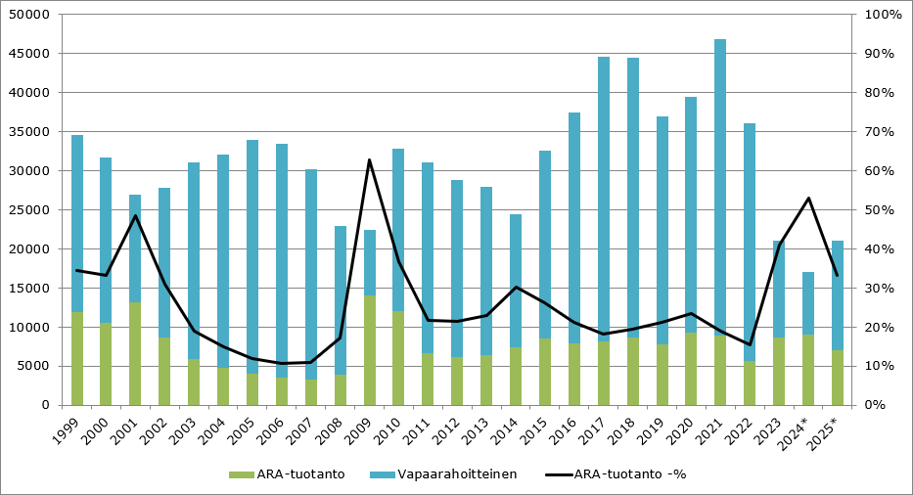
Home construction starts in Finland 1999-2025 Wide Social Housing Production has been Important to Prevent Homelessness
Market Housing
Social Housing (Ara)

Slide 43
Right-wing Government is reducing social housing and subsidies dramatically
The Government will direct social rental housing more efficiently to people on low incomes or with little wealth and specific groups that find it difficult to rent a home through the private rental market.
The income limits for social rental housing will be reinstated
The Government will reduce the amount of social house building by ARA in a controlled manner
No subsidies will be given to new right-of-occupancy homes
The role, position and tasks of ARA will be reviewed, including with regard to the future forms of EU funding for construction = Ara will be shut down at the end of February 2025…
The rate of investment grants for specific groups will be reduced: from 120 M€ to 15 M€/ year
The appropriation for housing guidance grants were halved : from 4 M€ to 2 M€ / year
The number of lift and accessibility grants will be reduced: from 21,5 M€ to 7,5 M€/year
Guarantee fees (0.5 per cent) will be introduced for new state-subsidised interest-subsidised loans for rental homes, with the exception of house building for specific groups

Slide 44
What works and what doesn’t?
Positives | Challenges
National political decision Broad acceptance of Housing First Cooperation between municipalities and shelter providers Economic incentives towards more Housing First-based support The National Partnership of stakeholders | Inadequate Housing solutions Cooperation between municipalities and shelter providers Cooperation inside the municipalities and cooperation across sectors Uncertainty in implementation of new legislation Inadequate data Mindshift to Housing First – both shelters and inside municipalities

Slide 45
Personal experience – having a home after homelssness
“When one's background is stable, you can start working with yourself and the fact that you have been homeless. If you don't have a place you can be, it's hard to start working on yourself because there is so much clutter.”
Citat: https://realdania.dk/publikationer/faglige-publikationer/fra-hjeml%C3%B8shed-til-egen-bolig (s. 19)
Picture: (Katya Støve-Rasmussen, 2020/2024), Hjem til Alle

