Slide 2
Health services and Housing First: integrated vs stand-alone services Marlene Panzenböck, neunerhaus – Vienna, Austria
Notes:
Allow me to briefly introduce myself: I am a social worker by profession and currently project manager of Housing First and Floating Support at the NGO neunerhaus in Vienna, Austria and a lecturer for social work and Housing First at the university of applied sciences Vienna.

Slide 3
Homelessness and health - context
Infrastructure for people who are homeless is comprehensive, but there are still gaps and challenges
Access to accommodation services is subject to requirements (residency status, social security entitlements)
It is estimated tens of thousands of people in Austria do not have health insurance
Others with health insurance but other barriers to access (language, navigating system, stigma, negative experiences)
20,573 people registered as homeless in Austria in 2023
11.400 people in Vienna (55%)
Source: Statistik Austria 2024
Notes:
I want to give a few quick points to outline the context of homelessness and health in Austria for those who may be less familiar with the system. Austria has around 9 milllion inhabitants, 2 million in the capital Vienna. In 2023, 20.573 people were registered as homeless in Austria, over half were registered in Vienna, where neunerhaus operates. Naturally the actual number of people who are homeless is likely to be much higher as these numbers do not reflect those in overcrowded or unsuitable housing or in situations of ‚hidden‘ homelessness.
Vienna has a comprehensive infrastructure of homelessness support services, but there are gaps and challenges. Access to accommodation services, such as supported housing, requires certain conditions around residency and social security entitlements, and for people who do not meet these requirements, there is very limited availability of emergency and short-term accommodation.
There are also gaps in health provision. Estimates suggests tens of thousands of people in Austria do not have health insurance, meaning their access is limited to a small number of low-threshold health services that support people without insurance, such as the neunerhaus health centre. Others may have health insurance but do not access health services for a number of other reasons, including difficulty navigating the system, being unaware of entitlements, language barriers, feelings of shame or negative experiences and discrimination in the past. These are also some of the service users supported within our housing first program.

Slide 4
neunerhaus…
…is a social organisation that enables people who are homeless, precariously housed and people at risk of poverty to lead a self-determined and dignified life through housing, health services and social participation.
Housing
neunerhaus operates three Housing First teams (Housing First and Floating Support) and three supported housing services in Vienna. neunerhaus also founded a subsidiary social housing agency, neunerimmo, in 2017.
Health
neunerhaus offers health services to people who are homeless or precariously housed, regardless of health insurance status. Over 5.900 people received medical care in 2023 in the neunerhaus health center and through our mobile team of doctors.
Social participation
Social workers offering low-threshold advice and support are available in both the neunerhaus health centre and the adjoining neunerhaus café. The café offers a space offering healthy food on a donation basis and where people can socialise without the pressure to buy.
Notes:
To begin, a quick overview of neunerhaus to explain a little about our work and how we have gained the insights we have over the past years. neunerhaus supports people who are homeless, precariously housed and those who are at risk of poverty. Our work focuses on three main themes – housing, health and social participation.
In the area of housing, we have a housing first program and floating support as well as three accommodation services, both transitional and longer-term services. In 2017 we also founded a subsidiary social housing agency – neunerimmo which builds the bridge to the real estate sector.
In the area of health, we have the neunerhaus health centre, open to people who are homeless, independent of their health insurance status. It is open five days a week. We have a general doctor’s surgery, including nursing care as well as a dental practice, mental health practice and a social work and peer work team. We also have a team of mobile doctors who work in homelessness services across Vienna, as well as a telemedical health advice helpline. These services are also open to other organizations, not just neunerhaus. In 2023 our combined health services supported over 5900 people.
neunerhaus believes low-threshold access to social work is a key measure to ensure social inclusion and participation. We have a social work team based in our health centre and also in our adjoining neunerhaus café. In the café, in addition to social work interventions, people also have access to healthy food on a donation basis. The neunerhaus café also offers people a space, open to all, where they can spend time and socialise without any obligation to purchase anything.

Slide 5
neunerhaus housing & health services
Health Center
Mobile doctors
Housing First & Floating Support
Health advice helpline
doctor‘s surgery
nursing care
dental practice
mental health practice
social and peer work
neunerhaus café
veterinary practice

Slide 6
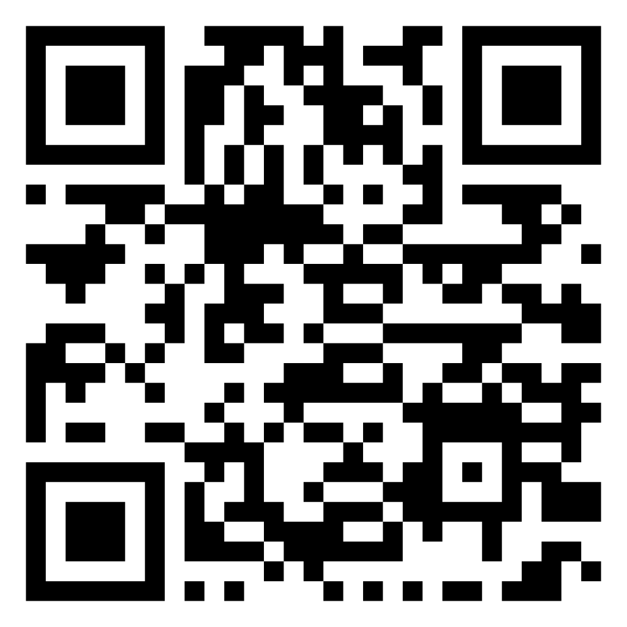
www.neunerhaus.at

