Slide 1
Housing First Programme – Mid West
Dr Harry Horgan – Senior Clinical Psychologist, HSE Mid West Housing First Team

Slide 2







Slide 3
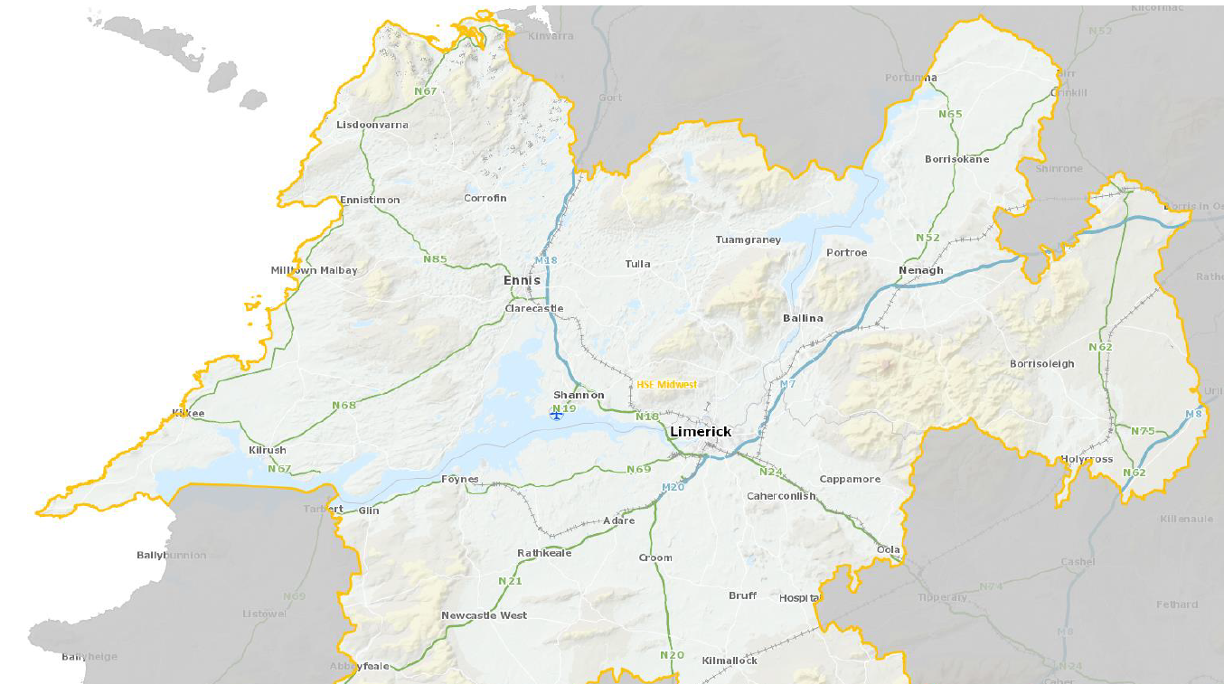

Slide 4
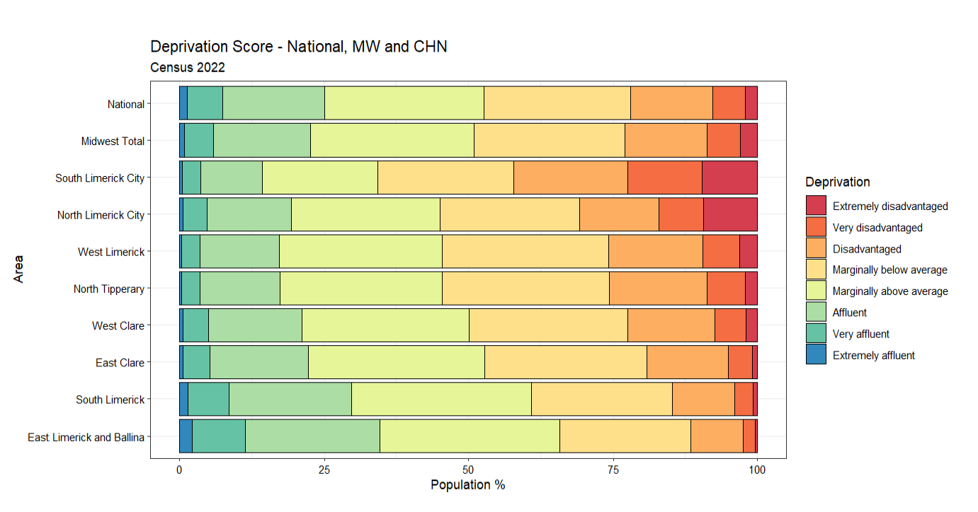

Slide 5
Housing First
National Picture
Internationally recognised evidenced based model
Long term homeless with complex needs
Housing for All 2030 (Both Housing & Health Sponsored)
Housing First National Implementation Plan 2022-2026
Local Picture
HF Tenancies Clare 14, Limerick 37, North Tipperary 10
33% Women, 67% Men
Majority aged 26-44
Co-occurring addiction and significant mental health problems more common than not
Notes:
Housing First is an internationally recognized evidence-based model and was developed in New York in the 1990’s by Dr Sam Tsemberis in response to the needs of those sleeping rough with severe mental illness.
The programme provides a comprehensive and holisitic approach to addressing homelessness for people experiencing mental health, physical health, substance misuse, social, behavioural and other challenges. The programme is based on 3 components:
Immediate access to permanent affordable housing without pre-existing conditions.
Mobile Case Management and wrap around supports
Client Choice and Recovery
Housing First is a critical component of the Government’s strategy to reduce and eliminate long-term homelessness.
In Ireland a National Implementation plan for Housing First was published in 2018. The plan commits Ireland to the rollout of Housing First in every county and sets annual targets for each local authority. Under the Housing First National Implementation Plan 2022 - 2026 it’s target is to provide an additional 1,300 tenancies nationally. To date the project has retention rates of 87% for people.

Slide 6
Housing First Partnership Approach
HSE – Social Inclusion
Focus Ireland
Local Authority
Notes:
For Housing First to work it requires a joined-up approach between Government Departments, local authorities, the Health Service Executive (HSE), service providers and voluntary housing bodies.
The policies I mentioned earlier recognise that many individuals experiencing homelessness have additional supports, Housing First also aligns with national policies on mental health and drugs such as Sharing the Vision (2020) and Reducing Harm, Supporting Recovery (2017). These policies are focused on recovery and harm reduction and recognise the strong inter-relationship between mental health, drug addiction and homelessness.
In Ireland’s Housing First progamme, the required housing stock comes from social housing (publicly funded housing managed by local authorities and AHBs). The case management support services is provided by NGOs and the treatment or wraparound supports is provided through the HSE and other social service providers.
This ensures a collaborative partnership approach that provides housing and support services which aid recovery and community integration for the programme’s participants and as a result participants achieve higher rates of housing stability and significantly greater improvements in quality of life.

Slide 7
Housing First Team
PERSON
Case Manager
Housing First – Health Co-Ordinator
Psychologist
Public Health Nurse
Community Mental Health Nurse
Occupational Therapist
Health Inclusion Worker
Drug & Alcohol Worker
Community Integration Worker
Notes:
I just want to give you an overview of the HF Health team which will be fully operational in the coming weeks:
My role is the HF Health coordinator. My role is to provide and lead on intensive case management and wrap around supports for service users. I work to enhance the interagency collaboration between HSE social inclusion team, the local authority and focus Ireland as our service provider.
The Housing support Worker has responsibility for supporting the SU with tenancy related matters such as rent, bills, maintenance and support with independent living skills
The dual Diagnosis Worker offers tailored one-to-one support in the areas of mental health and addiction.
The Health Inclusion PW supports the service user to receive appropriate and health care in teams of co-occurring general and mental health and substance use.
The drug and alcohol worker will provide interventions to SU that promote harm reduction and recovery.
Also, on our team we have a senior Clinical psychologist who formulates and implements plans for psychological intervention based on theoretical framework.
These roles here at the right are specific to HF program.
The housing first service user also has access to supports from the PNH , OT and Community Mental Health Nurse all of whom have a wider remit to support the housing first service users and the general homeless population.
Looking back it’s a really comprehensive team of supports.

