Slide 1
Ending Homelessness with Housing First: where do we find housing?
19 11 2024

Slide 2
Introduction
Mirthe Biemans
mirthe@housingfirstnederland.nl

Slide 3
Dutch context
Decentralized government
Housing First since 2006 (pathways)
Now: almost one third of municipalities
1500 a year, 6% of homeless people
Positive results, but staircase model dominant
Transition to system change:
Dutch National Action Plan on Homelessness: Housing First (2023-2030)

Slide 4
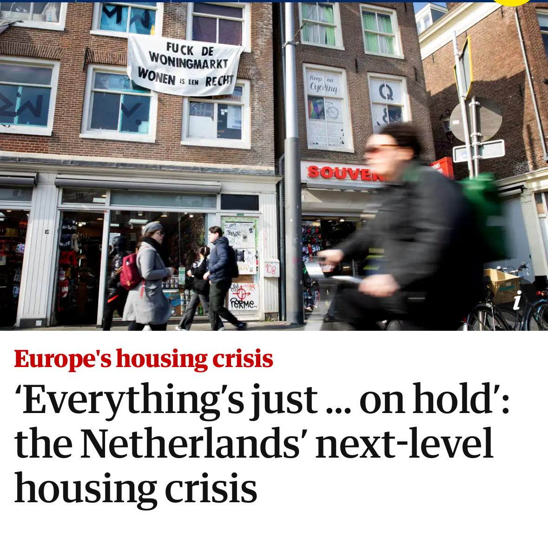
Housing context
Housing shortage: 300,000
0.5 million people looking for housing
Outcry when it affected middle class
Formally 30,000 homeless, probably triple
Focus on home ownership
History of social housing associations

Slide 5
Challenges for the right to housing
Availability of affordable housing
‘Competition’ between home seekers
Trust between care organisations and housing associations
Culture of risk aversion

Slide 6
Opportunities and ways forward
Housing homeless priority for housing associations
Housing homeless by for-profit real estate owners as part of ESG/CSR
Cost effective for government: 70,000 vs. 20,000 EUR
What we offer
Expertise on Housing First
Taking on all perceived risks
No need for ownership, long term management sufficient

Slide 7
Contact
Any questions left for
Housing First Nederland?
Feel free to contact!
info@housingfirstnederland.nl
www.housingfirstnederland.nl
www.linkedin.com/company/housingfirstnederland

