Slide 1
Housing First in Ireland - The Front Row
Rob Lowth – Housing First National Office
19th November 2024

Slide 2
Tenants in Housing First Ireland
1049

Slide 3
Best Goal Celebration

Slide 4
Thank you to everyone attending
“It’s a life altering solution for a bunch of people you’ve never met”

Slide 5
Oversight
Without HEALTH, we have no Housing First
The Co-Design of Housing First by both Department of Health and Department of Housing was essential buy-in
Oversight is by both Departments in a Co-Chairing arrangement drives collaboration
Reviewing and challenging the model constantly to ensure we are delivering the most dynamic solution available to support our tenants

Slide 6
Housing First National Office
Cross Gov Departments
(Housing, Health, Justice)
Secondary Gov Departments (Pobal, Social Protection)
NGOs AHBs
HSE Social Inclusion / Primary Care
31 LAs
Community Supports

Slide 7
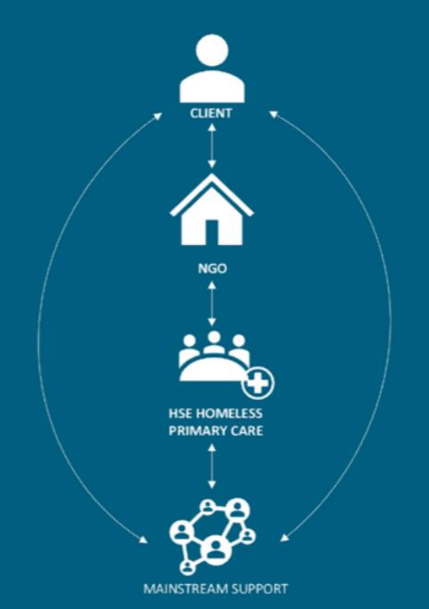
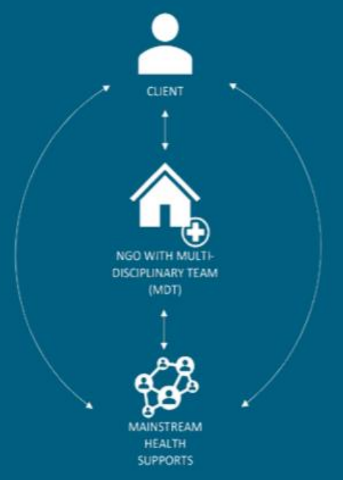
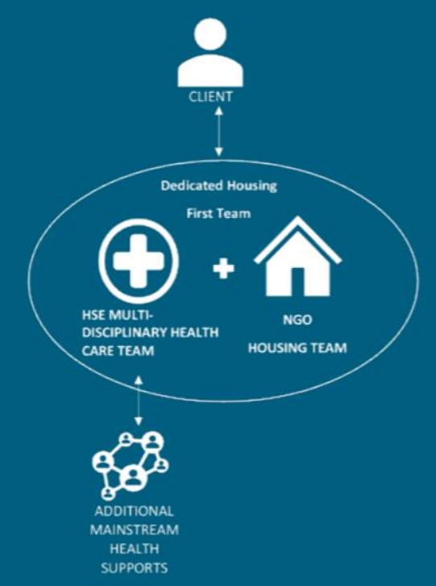
Health Supports

Slide 8
The Impact
- Traveller Community
- Youth 18-25
- Rough Sleepers
- Prison Exits
- Long Term Homeless
- Aging Population
- Domestic & Community Violence
- Family Re-Connections

Slide 9
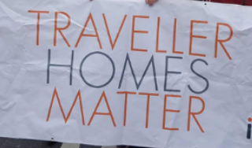
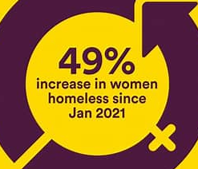
Mixed Tenant Background
Success working with members of the traveller community and leveraging regional traveller groups to provide additional wrap around support
Young people who meet the selection criteria for housing first are successfully housed
The current breakdown is 75/25 on male to female and we are reviewing this with a lens on the female barriers and safety concerns
Persons with a history of homelessness age faster than the rest of society, added complexity
Our model provides an opportunity for those who would never be sustainably housed
Tailored solutions for individuals because complexity requires time to listen and implement the right tenant strategy

Slide 10
The Picture
Over 1000 Tenancies, 50% in the Greater Dublin Area
In the next 12 months the numbers outside Dublin will increase faster per targets.
Regionally the programme has become a primary solution, “Can we use HF”?
Collaboration across LAs, NGOs, HSE, Government Departments is key to achieving sustainable outcomes for tenants
Enhancing the Lived Experience and moving towards a greater level of employed Peers
Community Integration – This reconnection has become a reality
Regional Quarterly Meetings – Inspiring and Solution Focus to Gaps

Slide 11
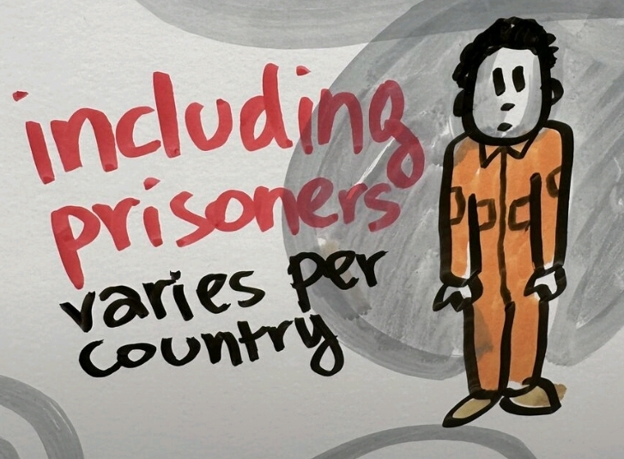
Prison Exits to Housing First
Part of the Mainstream Housing First, no need to rebrand or title, enhanced communication is required with the Prison Service
Working successfully with the reintegration to society for those who meet the housing first criteria and are in the revolving door of prison system
Health Communication from Prison is fundamental
Working with Dept of Justice to secure additional funding to support and enhance overall service improvement

Slide 12
Acquisition Fund / Delivery
Housing Agency €35 Million Rolling Fund to Support NGO AHBs, LAs or General ABHs
Designated for Dublin, South East, North West to support the 2022 missing delivery , Working on having national to support
NGOs Running a Housing First Service should be only focused on the Support
Homeless Area requires a SPV to tackle difficult to deliver 1 bed / studio
Could this be collaboration of Larger AHBs??? Percentage of output?
The Solutions – Group Units, 1 Bed Bungalow, 3 Bed conversion to 1 bed x 2

Slide 13
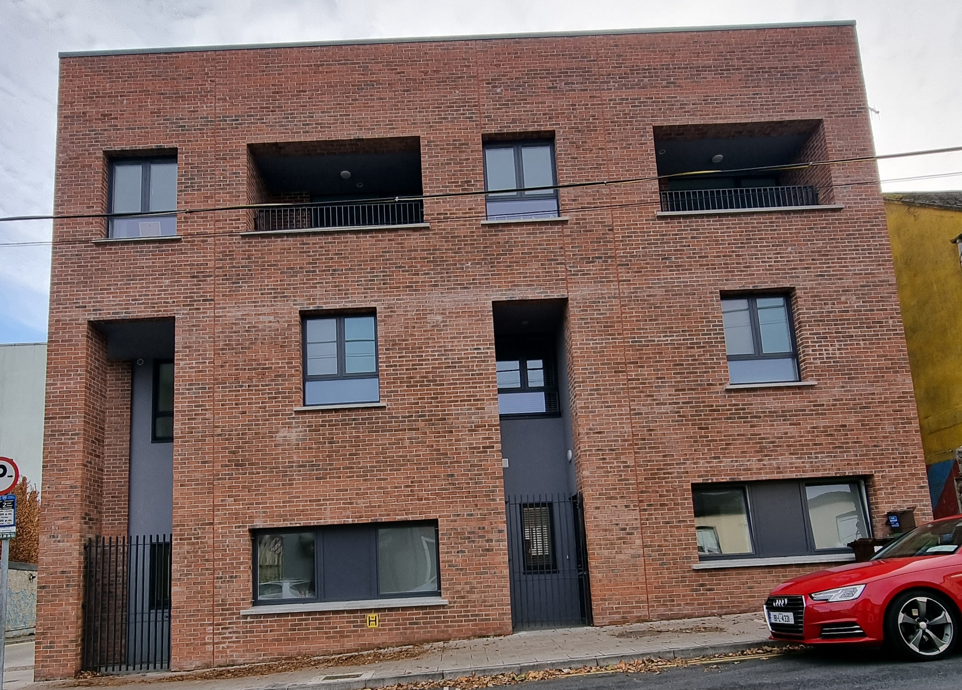
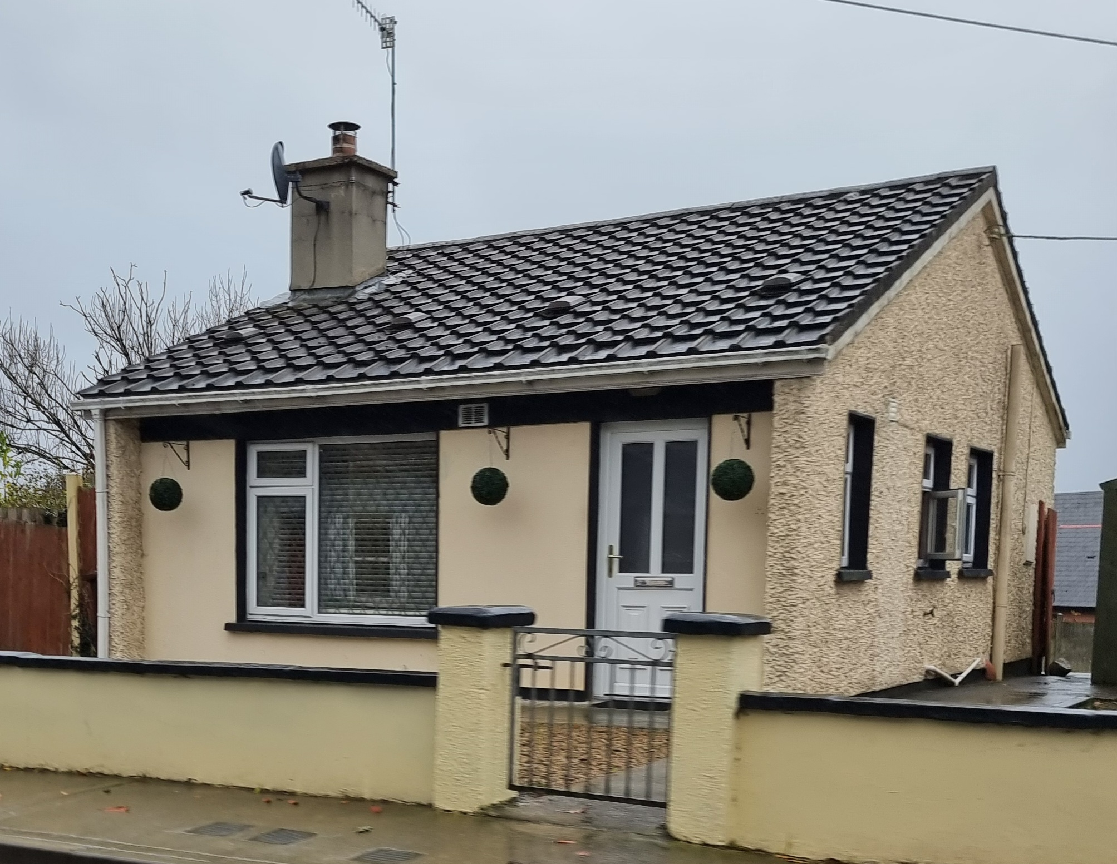
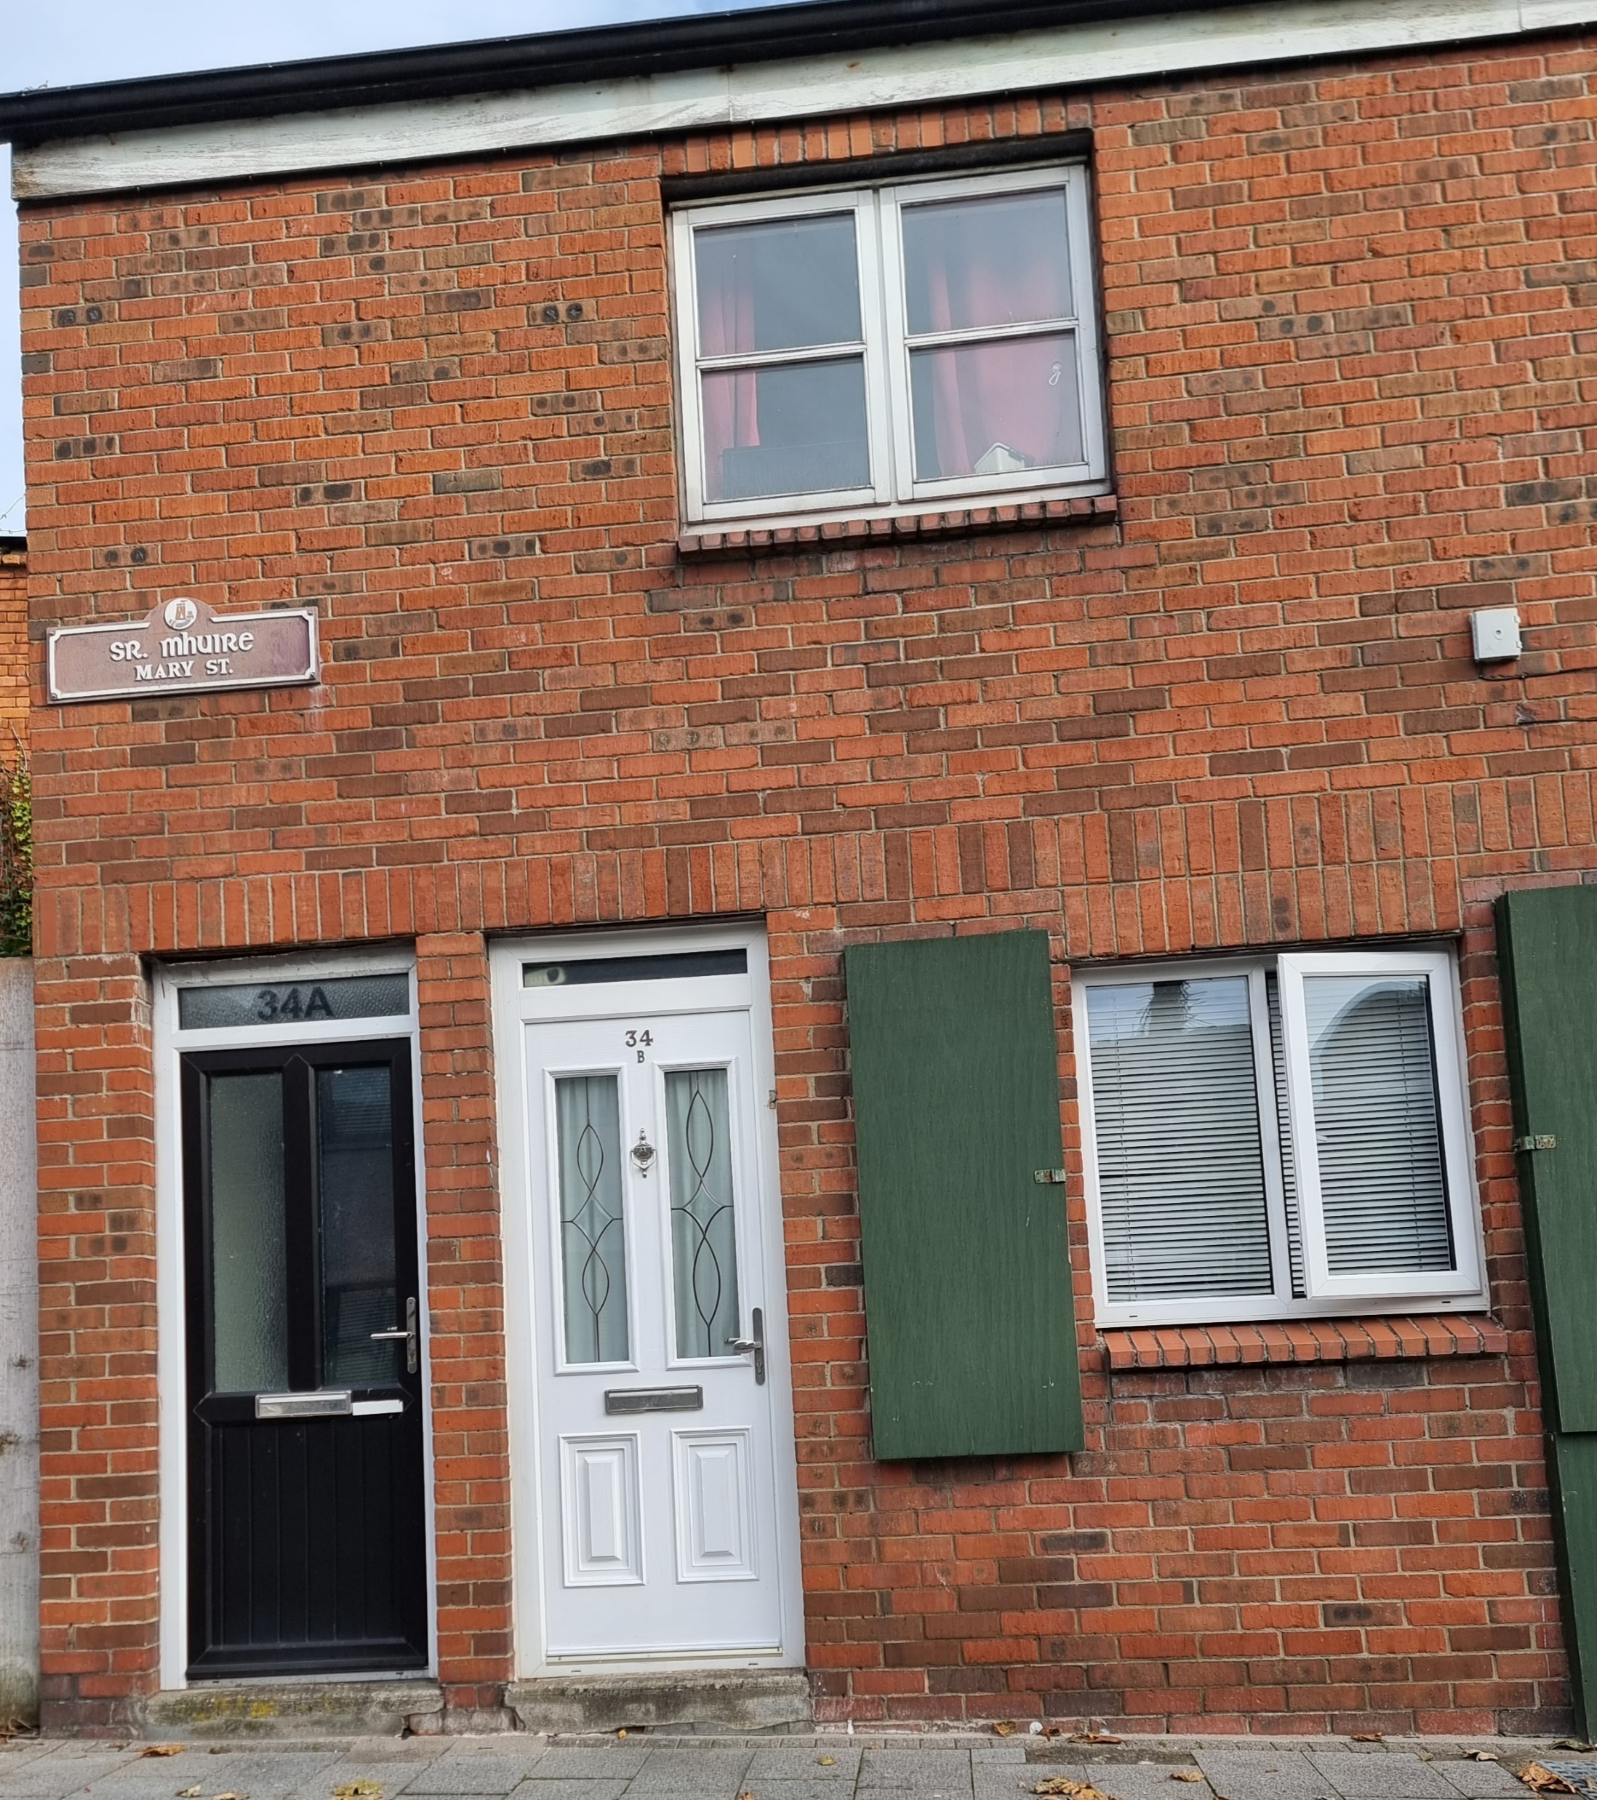
The Solutions

Slide 14
Impact on Tenants
Impact of Narco Terrorism
Direct Impact on Housing First Tenants
Regional Gangs control the drugs available – and harm caused
Cuckooing by drug dealers to cut and cook product
DRIVE Programme Garda Response
Crack & Synthetic Benzos the single biggest risk to communities

Slide 15
Challenges Faced
The labour market for both Clinical and Non-Clinical roles requires creative stimulation to encourage the point of college entry
Managing the shrinking city and towns scatter site aspect, balance of tenants who require higher levels of support v’s those on harm reduction / recovery path
With only 6% of Property in Ireland 1 Bedroomed, the sourcing and delivery is more important than ever
As we have seen the impact of Crack requires solutions such as the access to stabilisation units to support tenants (Dub Simon)
We welcome and embrace more NGOs in the delivery of Housing First, the fidelity culture developed in collaboration is the binding factor

Slide 16
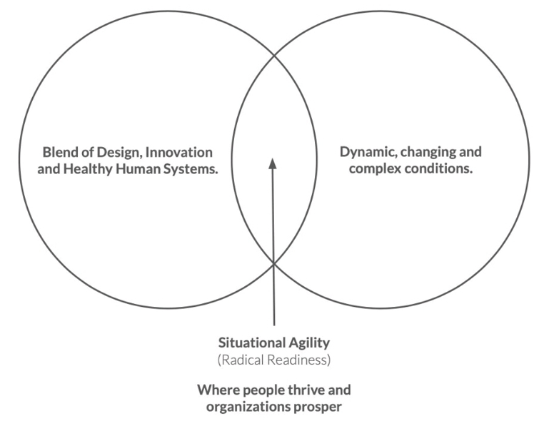
The Housing First Staff
Radical Readiness

Slide 17
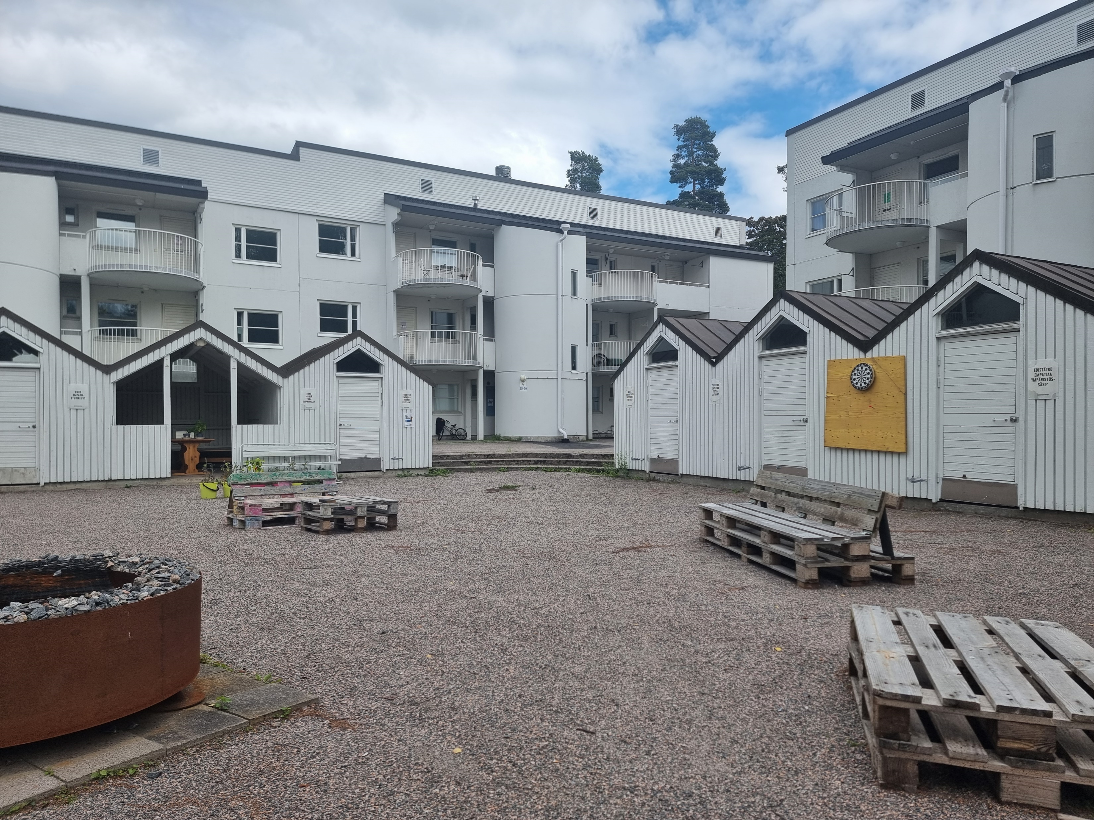
The Future Outlook

Slide 19
Thank You
Tel: 087 4153808
E-mail: rob.lowth@housingagency.ie

