Slide 1
Mental Health and Self Care
IN Housing First
Gerard Spillane

Slide 2
What are we Going to do?
Introduction
Ancient wisdom
Wounded Healer
Supporting the Healer

Slide 3
Self-CAre
Find Meaning: Reconnect with activities and hobbies that bring you joy and fulfillment. This can help restore a sense of purpose and balance.

Slide 4
Ancient Wisdom: Culture of Support

Slide 5
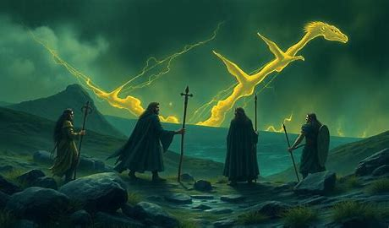
Quest
This Photo by Unknown Author is licensed under CC BY-SA
This Photo by Unknown Author is licensed under CC BY-SA

Slide 6
The Táin Bó Cúailnge, The Heavy Stone, Our Souls etc illustrate that individual heroism, while admirable, is not enough to overcome great challenges.
The Epic tales underscore the value of teamwork, collective effort, mutual support, strategic cooperation, kindness and empathy and the need to take time for ourselves to recover in achieving common goals
This Photo by Unknown Author is licensed under CC BY-SA-NC

Slide 7
What the Connection between Ancient Wisdom and Housing First
Wisdom
Housing First
Brehon Law: community responsibility for the those experiencing difficulties.
Meitheal: emphasis on the concept of mutual support, co-operation and community bonds
Talkoot: is the finish equivalent
Ubuntu: “I am because we are”, highlighting the importance of community and mutual care.
person Centered
Community integration
Harm Reduction
Immediate Access to Housing
Self-determination

Slide 8
Culture of Care
Just as self-care involves taking steps to maintain one’s own health and well-being, team care involves practices and behaviors that promote the health and well-being of the team as a whole.
Statutory
Team
SELF
Organisation

Slide 9
What’s the Learning?
Recognizing the shared humanity and interdependence of individuals.
What changed? We moved from community to isolating and othering people from the source of their support

Slide 10
Attachment Theory
Presence of a bond that ensures safety and security.
Attachment theory the writers of the bible could think of no better way to describe hell then the absence of God or love.
We have created a society that is incompatible and inhospitable to people experiencing Homeless and we also share that space and that burden in society.
That is what most of the people we work with have experienced

Slide 11
Wisdom
What’s the Learning: The Person who is Homeless, The Voluntary agency or the statutory agency is not the problem the Slow Violence of Homelessness is the Problem. And its only working together can we solve it.

Slide 12
Quantitative v Qualitative thinking and Moral Injury
Focus on meeting targets
KPI’s
Rapid Rehousing
Moving to the next case
Numbers over Story
We need to achieve this target by this date
Target Group for HF.
The journey is just as important as the destination.
The true value of the journey was the knowledge gained along the way
Focus on the wisdom gained by the journey
Challenges to be over come
This story highlights the value of the journey itself and the growth and understanding that come from facing challenges together.

Slide 13
What is Housing First/What does it mean for Staff
Housing First is an evidence-based practice intended to serve chronically homeless individuals with co-occurring serious mental illness and substance use disorders.

Slide 14
Staff are exposed to
High Mortality Rates
Overdose
Domestic Violence
Physical Violence
Psychological Violence
Threats and abuse
Loss /Grief
exclusionary practice
Moral Injury

Slide 16
Wounded Healer
Homeless individuals with co-occurring serious mental illness and substance use disorders
Strauss et al (2018) reported that 40.2% SW had a mental health Issue before becoming social workers, increase to 51.8% during their career.
The well-being of social care workers is crucial, not only for their own health but also for the quality of care they provide to others. It is a personal, organizational and structural responsibility.

Slide 17
Staff Quotes
“The idea of “meitheal” embodies the spirit of cooperation and mutual support, emphasizing the importance of community and collective effort. It’s a beautiful example of how coming together can achieve more than working alone”.

Slide 18
Staff Quotes
“we held each other as we phoned emergency services as we knew that when we used the word deceased the finality of what happened would hit us”

Slide 19
Staff Quotes
“I felt guilty, I kept asking myself could I have done more. Could I have seen it coming, did I miss red flags. It was a difficult time before, but nothing compared to during and after the incident. Trying to support staff, friends of his who lived in the building, I even had to arrange for a pint of milk to be brought to a tenant that I had promised to get. Trying to maintain some level of normality and control can be difficult”

Slide 20
Staff Quotes
“I had spent more time with her than members of my own family. Given her life experiences I was determined to do everything I could to help her achieve her goals, everything was going so well and she just died. She had her own place, reconnected with her child, her recovery was going well, just when things were coming together for her she died of natural causes, I was heartbroken all her hard work gone the sense of unfairness is overwhelming”.

Slide 21
Staff Quotes
“Staff look to you for leadership and answers in crisis situations. Sometimes I feel overwhelmed by what is going on around me. Trying to put a brave face on it while inside I feel like collapsing under the weight of expectation and responsibility”

Slide 22
Staff Quote
“I was in a state of professional and person conflict trying to be professional and grieve at the same time. I didn’t think I could or would be allowed to do both”.

Slide 23
Supporting the Healer

Slide 24
We must wait for our souls to catch up
We must rest, evaluate and Listen to continue the journey.

Slide 25
Housing First Manual (IriSH)
“Organizations (whether statutory or NGO) which undertake to deliver authentic Housing First services must be prepared to invest in the wellness of staff members who may, through their work, be exposed to trauma, volatile situations, personal risk and grief”. (HF Manual;45)

Slide 26
Standards, Regulations and Declarations: creating a Culture of Support.
“The novel contribution of the paper lies in its key findings. Namely, that: the {CORU} format of the standards of proficiency framework itself warrants further consideration; insufficient attention is paid to empathy and emotions across standards”. De Roiste A, Mulkeen M, Flynn S, Conroy S 2024 Social care work and social work in Ireland: a comparative analysis of standards of proficiency
NQSF Themes Focus on the service user, they should also focus on the supports for staff.
There is no specific mention of staff wellbeing or the importance of staff to the successful outcomes in the Lisbon declaration.

Slide 27
Hierarchy of Support Individual and Organisational
EAP
CISM
Training
Supervision
Reflective Practice
Team (Meitheal) Culture

Slide 28
Hierarchy of Support: Structural.
Recognition
Q&Q
Appropriate Wrap around Support
Housing (Ring Fence, Mescan)
Funding/Ratios
Team Culture (Equal but different skills)

Slide 29
What are we doing?

Slide 31
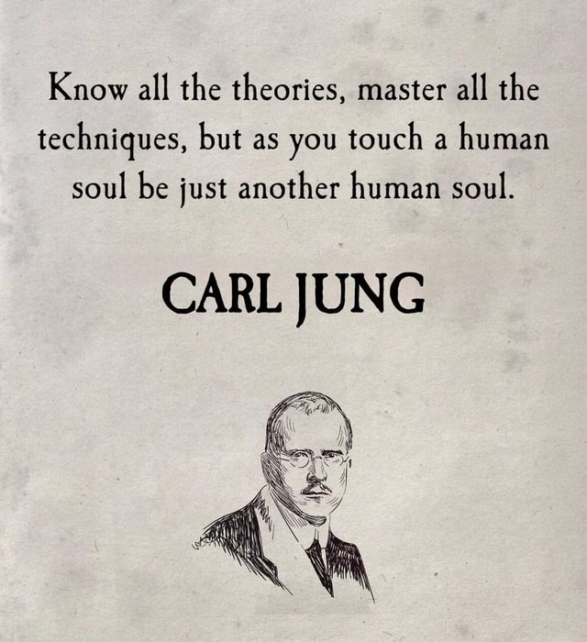

Slide 32
What we do as an Organisation
Destill it down we are sharing our story with our tribe
Historically shred experience, isolation, empowering
Oranisational values
Supervision, Reflective practice, CISD, EEAP, what is the common function/Method/Mode across these interventions?

Slide 33
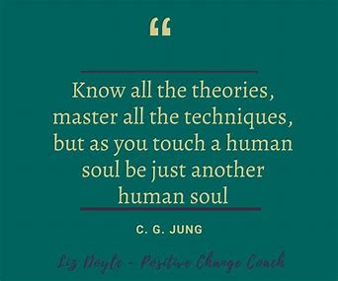

Slide 34
SonGLines
|Singing Creation into existence
During the famine, the music left the land
“People reflected sadly on the the silence that had been inflicted on the land of song by the famine”
All joy had gone, it was a barren landscape and it was a hand to mouth existence.

Slide 35
800yrs of stigmatizing Homelessness, that informs our approach how do we unpack this what is the antidote to
Staircase model
Housing Model (Housing First)
Choice Based Lettings
(Practice Model) Trauma informed care
(Practice Model) Psychological Informed Environments
Notes:
Describe the principles of the above and compare to the ancient wisdom of Brehon Law, Umbuntu kallok,

