Slide 1

Housing First
Leading the way together

Slide 2


History of the Service
Belfast Pilot 2013 – now current provide a HF service across 2 major cities in NI
Case Management & Case Coordination
1 x Project Group Manager
1 F/T Deputy Manager
5 F/T Case Workers
What we don’t have is dedicated mental health workers/or addictions support specialists. These services are sources externally. There are no formal agreements – we have a communication protocols in place
Trauma Informed Practice
Adult service
2018 – Fidelity Assessment
HOUSING FIRST: LEADING THE WAY TOGETHER
Nov 2024

Slide 3
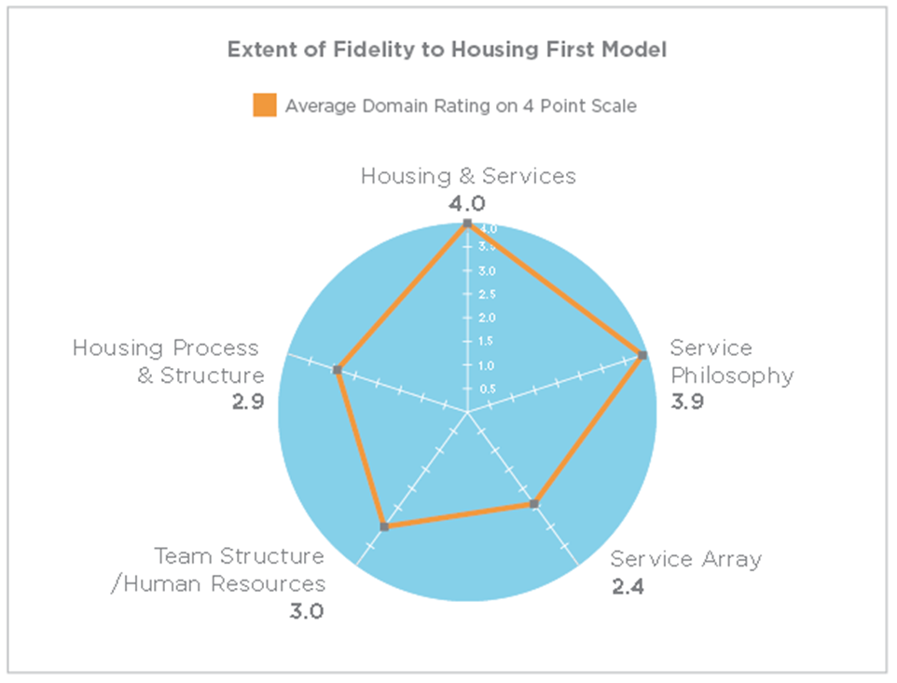
2018 - Fidelity Assessment
Housing Process and Structure
How Housing and Services are related
Service Philosophy
Service Array
Team Structure and HR
HOUSING FIRST: LEADING THE WAY TOGETHER
Nov 2024

Slide 4
Key Findings
Depaul Housing First services operate with a high level of fidelity to the internationally recognised standards for Housing First.
Lack of housing supply had a considerable impact on the capacity of the Housing First service.
Housing First team have developed strong working relationships with statutory and community based services. Albeit there was and remains a lack of formal agreements with statutory & community services which means that supports can be is restrictive.
Service Users integration within their new communities was a significant issues identified which affects the fidelity of the service delivery model.
HOUSING FIRST: LEADING THE WAY TOGETHER
Nov 2024
Notes:
Depaul Housing First services operate with a high level of fidelity to the internationally recognised standards for Housing First. However, the lack of housing supply has a considerable impact on the capacity of each of the Housing First services.
There were 87 successful placements made by the service from 2015 to 2017. This equates to 74% of service users worked with in the same period of time.
Depaul Housing First teams have developed strong working relationships with statutory and community based services to support the work of wrap around services for service users in their tenancies,
however the lack of formal agreements with these services is restrictive.
Integrate within their new communities is a prevalent feature that affects the fidelity of the service delivery model.

Slide 5


Case Numbers
The figures to the right represent the total number of individual cases and total individual people that Housing First has worked with since launching in 2013 up to June 30th, 2024.
Keep in mind that some individuals have left and re-joined the service multiple times i.e. 1 individual could represent 2 or more cases.
The live cases figure is a snapshot demonstrating how many cases are live at a given time.
698
397
47
Total Cases up to 30/06/24
Total number of Unique Individuals to Date
Total Live Cases on 30/06/24
HOUSING FIRST: LEADING THE WAY TOGETHER
Nov 2024

Slide 6


Gender Split
Based on the figure of 397 individuals from the previous slide:
288
109
0
Individuals who identify as Male
Individuals who identify as Female
Individuals who Identify as Non-binary
HOUSING FIRST: LEADING THE WAY TOGETHER
Nov 2024
Notes:
Invisibility of homeless women
Seeing an increase of women coming into HF – in keeping with what NIHE are seeing
Targeting women leaving prison

Slide 7




Age Range
Breakdown of the age range of service users accessing HF.
 | 22 | 102 | 126 | 86 | 54 | 7
<21
21-30
31-40
41-50
51-60
60+
Cases
HOUSING FIRST: LEADING THE WAY TOGETHER
Nov 2024

Slide 8
Support Activities
The figures below represent unique support interventions by type, demonstrating the volume and breadth of supporting activities carried out by HF staff.
2,340 Motivation & taking responsibility
2098 Offending
1,804 Managing Money
1,575 Meaningful use of time
2,044 Building social networks & relationships
46 Child Protection
22,115 Managing tenancy & accommodation
15,690 General support
9,916 Physical health
8,572 Alcohol use
6,375 Emotional & mental health
4,211 Self care & living skills
3,635 Drug use
HOUSING FIRST: LEADING THE WAY TOGETHER
Nov 2024

Slide 9
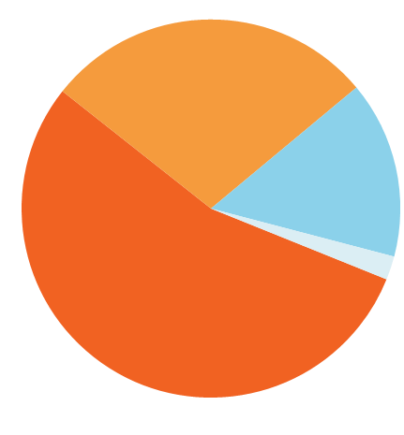
Time in Accommodation
This data set is in a sense incomplete, as we do not currently have the means to report on those service users who no longer access HF (but may have sustained their tenancy). Data includes some service users who have had more than 1 tenancy during their time with HF.
65
17
Further work required to determine if individuals remained settled in their tenancy after their case is closed as our system does not offer us the opportunity to provide this data.
1 – 2 years
2 – 3 years
309
6
Up to 1 year
3+ years
HOUSING FIRST: LEADING THE WAY TOGETHER
Nov 2024
Notes:
Can we change the slide to % of 284
Keeping in mind that this is accumulative That we have closed cases during each year so we are not monitoring if these individuals who are no longer engaged with HF hence why number appear lower as we get further through the years.

Slide 10
Key Agencies
The agencies listed below represent the main agencies with whom Housing First engage in order to provide a wraparound, case managed approach to supporting our service users.
G.P’s
NIPS
PSNI
Lifeline
PBNI
Aware
Solicitors
Community Mental Health Teams
Welcome Organisation
Homecare
ASCERT
Extern
NIHE/Housing Solutions Teams
Triangle Floating support
Housing Associations
Habitat for Humanity
Community Mental Health
Community Addictions Team
Hospitals
Drug Outreach Team
Food banks
Substitute Prescribing Team
Niacro
Adult Safeguarding Team
Physical disability Team
Health Inclusion Hub
Addictions NI
HOUSING FIRST: LEADING THE WAY TOGETHER
Nov 2024

Slide 11
Conclusions
HOUSING FIRST: LEADING THE WAY TOGETHER
Nov 2024

Slide 12
Where we feel progress has been made
Chronic Homelessness strategy and Action Plan
The temporary accommodation review, Interdepartmental Homelessness Action Plan
Common Assessment Framework (CAF) data sharing
Impact of Shaping current and future services
HOUSING FIRST: LEADING THE WAY TOGETHER
Nov 2024
Notes:
Recognition and appreciation of the Housing First Model as part of a continuum of services in tackling homelessness
Moving people directly into housing
Providers Investment fund allowed us to upgrade our client management system to collect data more accurately
CAF – centralised referrals via the housing solutions team into HF – There are regular referral review meetings to ensure that the referrals are suitable, prioritised and Housing options are explored
Sharing of experience, knowledge, collaboration, working with the all island HF platform & European Hub. Seeing the development of HF for youth via Simon community

Slide 13
Challenges & Solutions
Based on the upward trajectory of homelessness in NI and emerging health needs we urgently need adequate investment in Housing First to upscale the services across the two main cities and beyond
Multi-disciplinary housing & health teams with specific function of identification of high risk cases; signing posting and enabling access to relevant services – Complex lives initiative is a very positive approach (MDT)
Development of methods in which social isolation and community integration is addressed for the individuals under the Chronic Homeless strategy and Housing First cohort.
A development opportunity in this area is for peer involvement in the staffing model of Housing First services (HHPA)
HOUSING FIRST: LEADING THE WAY TOGETHER
Nov 2024
Notes:
Remove slide

Slide 14
Evidence Base – The need for a Multi Departmental Approach
Based on the evidence to date it is clear from the number of intervention relating to offending behaviour, health and addiction, a multi department approach is critical for the successful delivery and sustainability of a Housing First model of service. It is vital that along with Housing; Justice and Health are part of the future of Housing First.
HOUSING FIRST: LEADING THE WAY TOGETHER
Nov 2024

Slide 15
Our Asks
Interdepartmental Oversight and Direction with High level Departmental Commitment and Strategy
Housing Supply Strategy for HF - Affordability and Security of Tenure
Introduce a task force for Housing First
Northern Ireland Housing First Director
Publication of the recent evaluation report commissioned by NIHE to define the HF model in a NI context and its roll out more widely
Comprehensive Regional plan for the Roll Out of HF
HOUSING FIRST: LEADING THE WAY TOGETHER
Nov 2024

Slide 16
For more information, contact us at:
http://ie.depaulcharity.org/
HOUSING FIRST: LEADING THE WAY TOGETHER
Nov 2024

