Slide 1
Addressing Homelessness Rachael Barber, Director, International Community Programs, EMEA
The Citi Foundation

Slide 2
Our Mission
The Citi Foundation works to promote economic progress and improve the lives of people in low-income communities around the world.
For more information, please visit www.CitiFoundation.com.

Slide 3
What is the Citi Foundation’s Global Innovation Challenge?
A global request for proposals soliciting breakthrough innovations to help address some of the world’s pressing challenges.
This year the $25 million Challenge provided catalytic funding to community organizations working in novel ways to address homelessness.

Slide 4
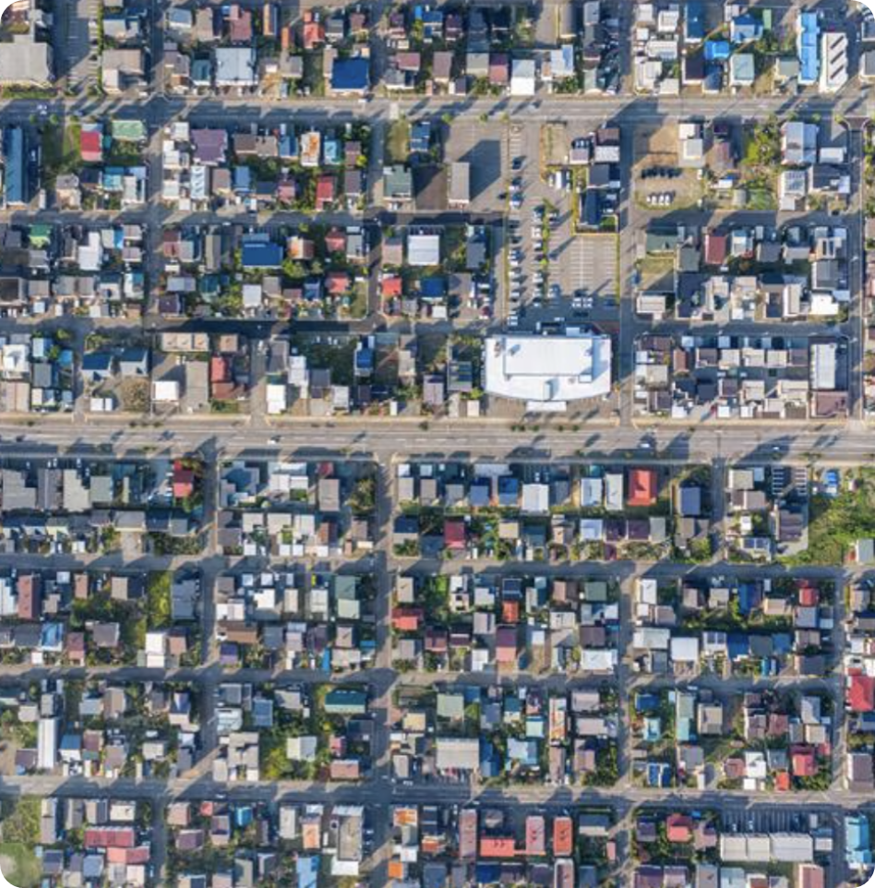
Global Innovation Challenge: grant overview
Award Amount: $500,000 (USD)
Grant Length: 24 months
Number of Awards: 50
Post Award Engagement: Citi volunteer support and a learning community

Slide 5
2024 Messaging Framework
March 2024
Internal
Community Investing and Development

Slide 6
Global Innovation Challenge Recipients 2024: Europe

Slide 7
Applications
We received over 800 applications in total, with some consistent areas of focus
Geographic
UK
France
Spain
Italy
Central and Eastern Europe
Themes
Housing First
Migration & displacement
Cash transfers
Employability
Access to healthcare
Demographics
Youth
Refugees & IDPs
Women
People with disabilities
LGBTQIA+

Slide 8
Innovation
Asociación Realidades para la Integración Social is developing a cohabitation model in Spain where individuals experiencing homelessness share housing and resources while receiving mental health support and other services.

Slide 9
Migration and internal displacement
Romodrom is providing housing solutions, such as assistance on rental applications, to Ukrainian refugees in the Czech Republic to reduce homelessness and enhance social cohesion.

Slide 10
Employability
PRAKSIS is providing individuals experiencing homelessness in Greece with specialized training for employment and entrepreneurship opportunities in agriculture and tourism.

