Slide 1
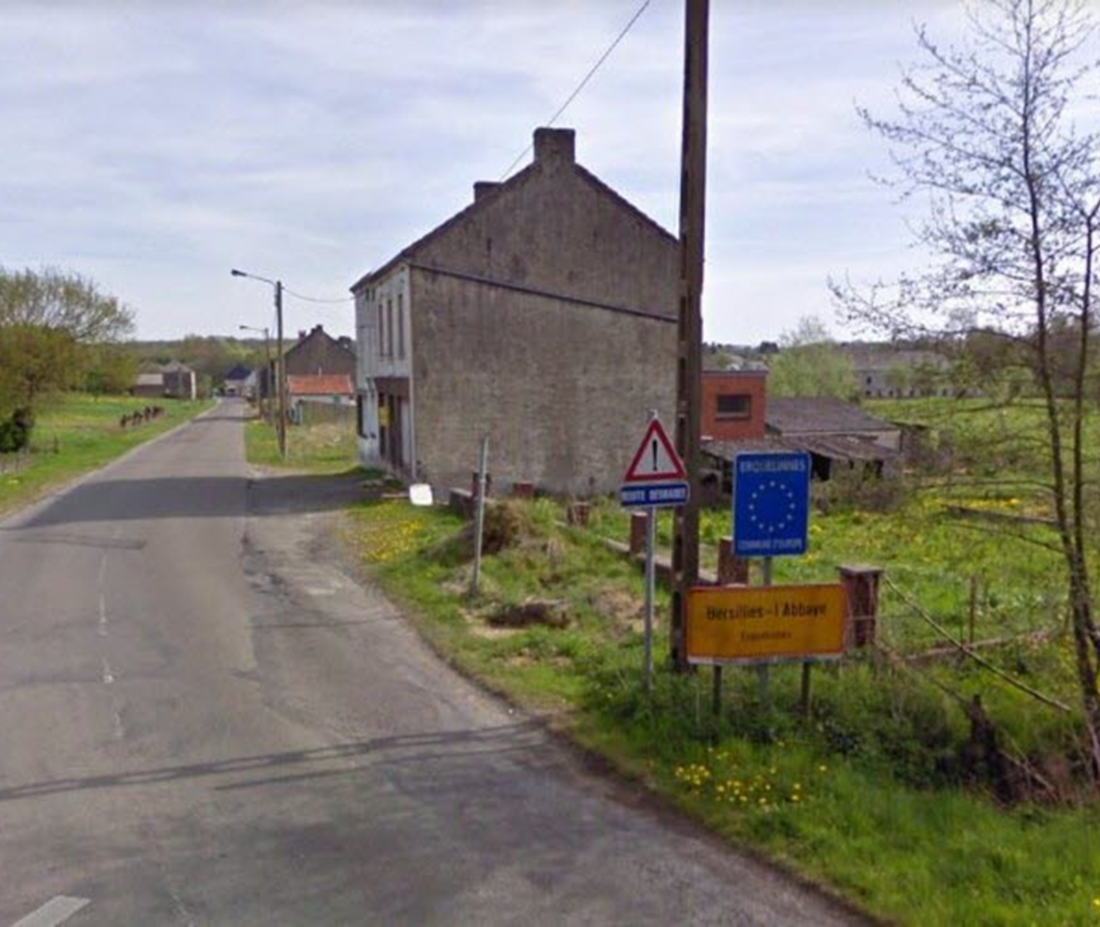
Housing First in rural and remote areas
Workshop - New Horizons in Housing First, Dublin 24
Victoria Long, Turning Point Scotland
Caroline Simon, Housing First Belgium Lab (Public service)
Chair: Raphaël Bouloudnine - DIHAL French government

Slide 2
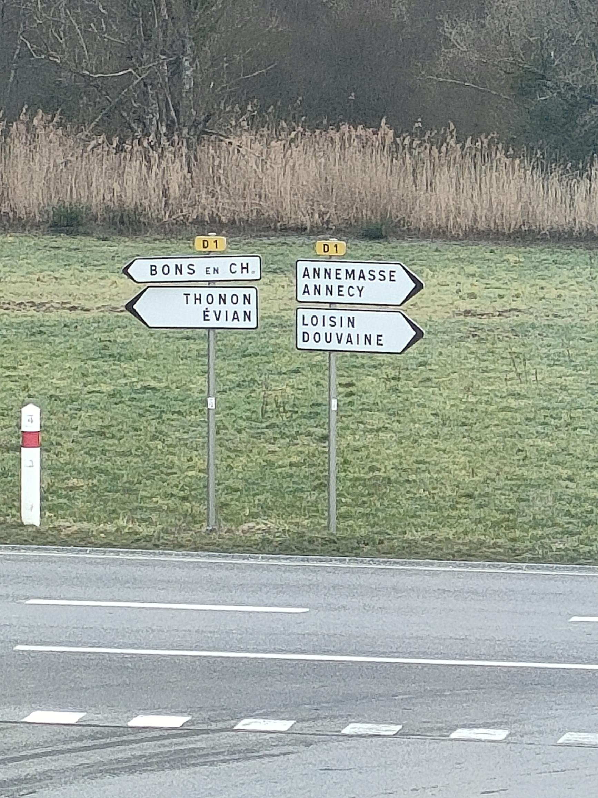
Outline – 13.45 to 15.00
Part 1 : Introductions
Background, impact and milestones
Part 2 : Challenges Faced... and potential solution
Part 3 : Key questions
Part 4 : Next steps and actions
Notes:
-hf vs. supported living for disabled people or elderly people
-housing options: also a hybrid model

Slide 3
Part 1 - Background
DIHAL French government XXX XXX
Housing First Belgium Lab
Center of expertise, coordination and support for HF teams established at regional level
Within the Federal Public Service ‘Social Integration’
47 HF services in Belgium, around ten rural

Slide 4
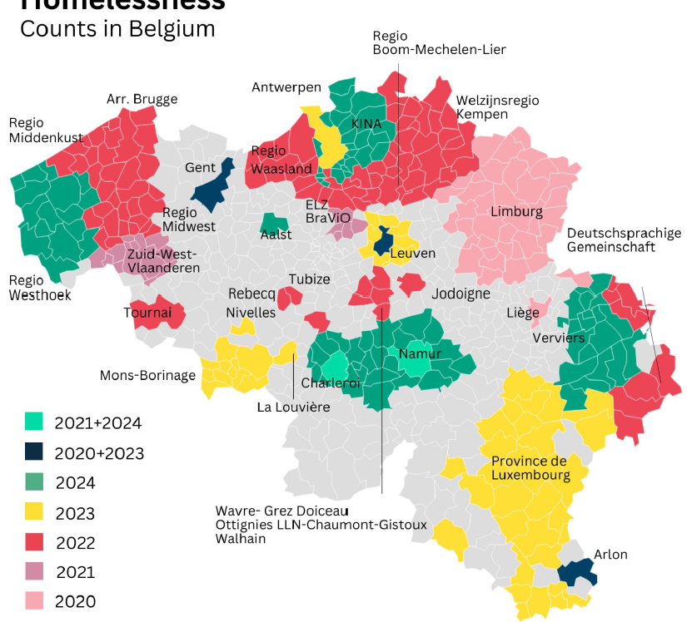
Impact /Milestones
Homelessness counts in Belgium – Epoch Practice 2024, Prof. Martin WAGENER (UCLouvain, KULeuven, Fondation Roi Baudouin)
In Walloon Region :
55,1 % of homeless people in municipalities with less than 30.000 inhabitants
Rural environnement :
Very few people in public space and emergency accomodation
More people in non-conventionnal housing and institutions
→ Proportions are quite comparable, but lesser visible -Needs of recognition of rural aspects of homelessness

Slide 5
Impact /Milestones
Vicky / Raphaël ?

Slide 6
Part 2 - Challenges Faced... and potential solutions ?
Mobility and transports
Network of the tenants
and
of the organisation
Access to services
Subsidies and fundings:
Different needs
Different fundings

Slide 7
Part 3 : key questions that people should ask them if they want to set up HF service in rural or remote area :
How large area can you provide the HF support without losing the principles ?
How are you going to keep the team supporting each other when they could be working far appart ?
How would you manage the expectations of the tenants with the constraints of the project ?

Slide 8
Part 4 – Next steps and actions :
- What can/should the Housing First Europe Hub do on HF in rural and remote areas ?
e.g. organise informal meetings, consider research/information gathering; develop training tools; engage in advocacy - at what level?
- What do you think government should do on this topic in the next 12 - 24 months?
e.g. local, regional, national or EU level
- What will YOU do on HF in rural and remote areas in the next 12-24 months ?
e.g. organise informal meetings, consider research/information gathering; develop training tools; engage in advocacy - at what level?

Slide 9
THANKS A LOT

