Slide 1

Welcome
Notes:
Welcome everyone.
To start off with, I would like to thank our conference team, and in particular, our colleagues at Focus Ireland for making this conference possible.
A special thank you to Emma, Emily and Mike - and all of their colleagues across Dublin and Ireland, The HF National Office of Ireland - Grainne, Shannon and Rob, who have worked hard behind the scenes to bring us all together for the next two days.
I'm delighted to see you all - I've had the privilege to work with many of you over the past few years; but there are lots of new faces - or faces that I've only seen on a screen - so I appreciate this chance to meet in person.
I wanted to start by saying a few words about the HF Europe Hub. Most of you here in this room are partners in the Hub - Core partners, associate partners, or linked through Communities of Practice, our cohorts of trainers, or our work on Research or youth, etc.
This conference is your conference - we've worked hard to design the plenary and workshop sessions to give you both an opportunity to share your own experiences and knowledge, and to learn from your colleagues from across Europe and beyond. This is a working conference - we want to be able to build on what we discuss today and tomorrow as a foundation for our working for next few years.
The title of the conference asks us to look to the future - what is on the horizon for Housing First, for our ambitious goal of ending and preventing homelessness?
We've been working together in the Hub since 2016, and there is much work and good opportunities on the horizon. And there is power in numbers as you can see today. Coming together like this gives us all the chance to connect, and hopefully we will go back to our local communities with renewed motivation.

Slide 2
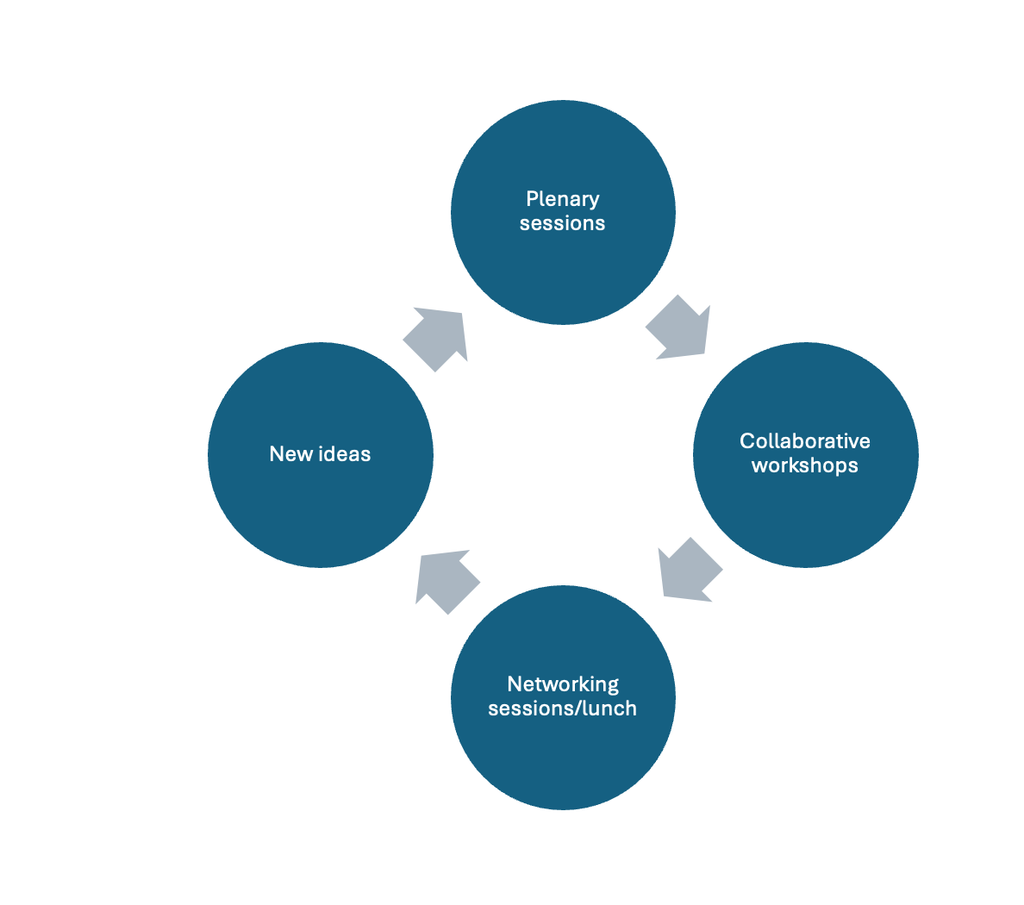

Slide 3


Slide 4


Slide 5
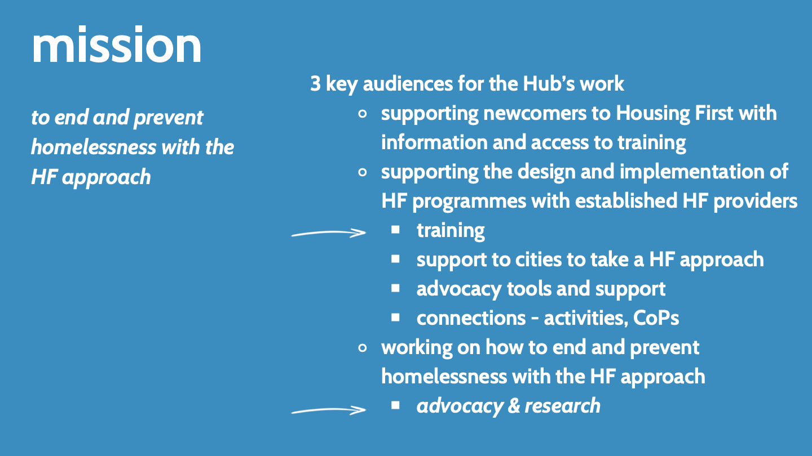

Slide 6


Slide 7
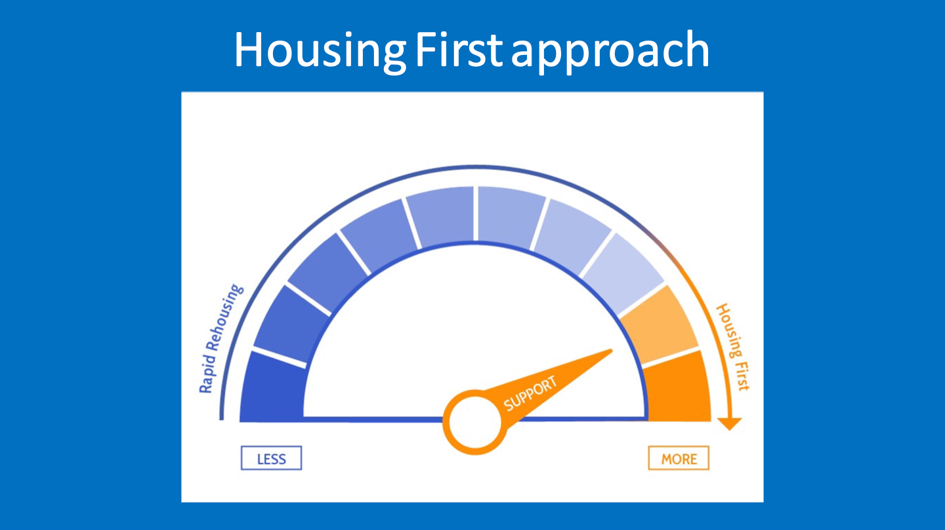

Slide 8
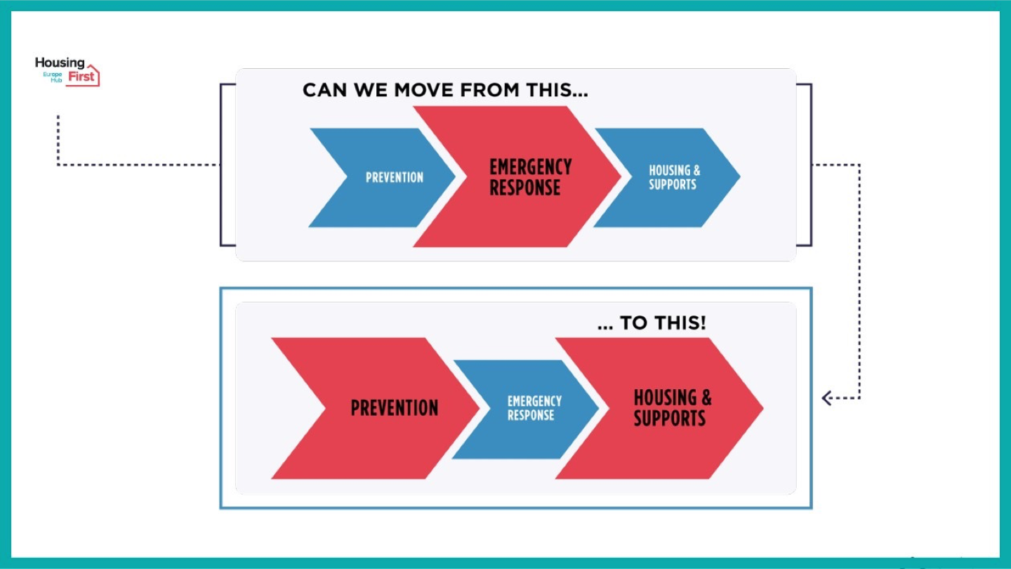

Slide 9

Knowledge development
Evaluation framework
Research digest
Webinars
Articles, blogs, support

Slide 10

Capacity building
Communities of Practice:
National Networks
Managers
Youth
Women
Housing

Slide 11

Training
Train the trainer programme
  6 cohorts
  growing pool of trainers
  Hub partners & beyond...
  Trainers' directory
  Trainers' symposium
Training resources
Introductory guides
Introduction to Housing First videos (EN, FR, ES)
On-demand training, on request

Slide 12

Housing First for Youth
Training & development support
  Czechia
  Belgium
  England
  Spain
  Wales
  Denmark
  Canada
  France
  Netherlands
  Ireland
  Scotland

Slide 13

What’s on the horizon?
  1
  2
  3
Collaborative planning for
2025-2026...
Capacity to do more - together
Opportunities for advocacy & impact
Notes:
As we head into the real work of the conference.
Don't forget - This conference is your conference. We are counting on all you to actively participate and engage - to take things back to your own countries/contexts, and to help us to plan our collaborative work for the next few years.
Intro to Juha
Juha Kaakinen
Senior Advisor – Y-Foundation
Juha Kaakinen was the Chief Executive Officer of Y-Foundation from 2013 until February 2022, when he retired from that post. He currently acts as a Senior Advisor to Y-Foundation, the biggest Finnish NGO acquiring flats from the private market for homeless people and providing social housing. From 2008-2012, he worked for the Finnish Ministry of the Environment as Program Leader of the National Program to reduce long-term homelessness. He is an experienced developer of, and advocate for, Housing First and social housing.

